Slide 1

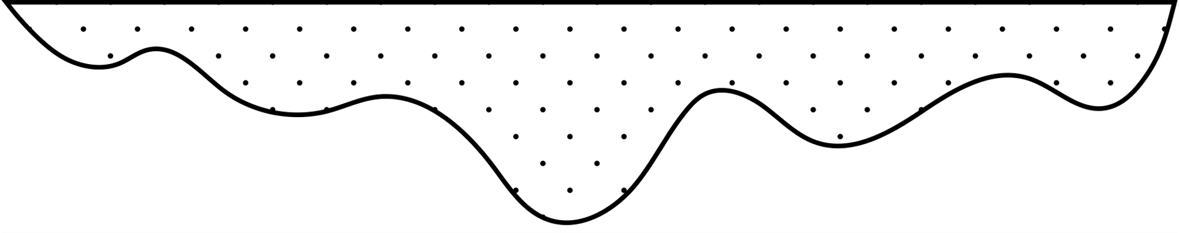
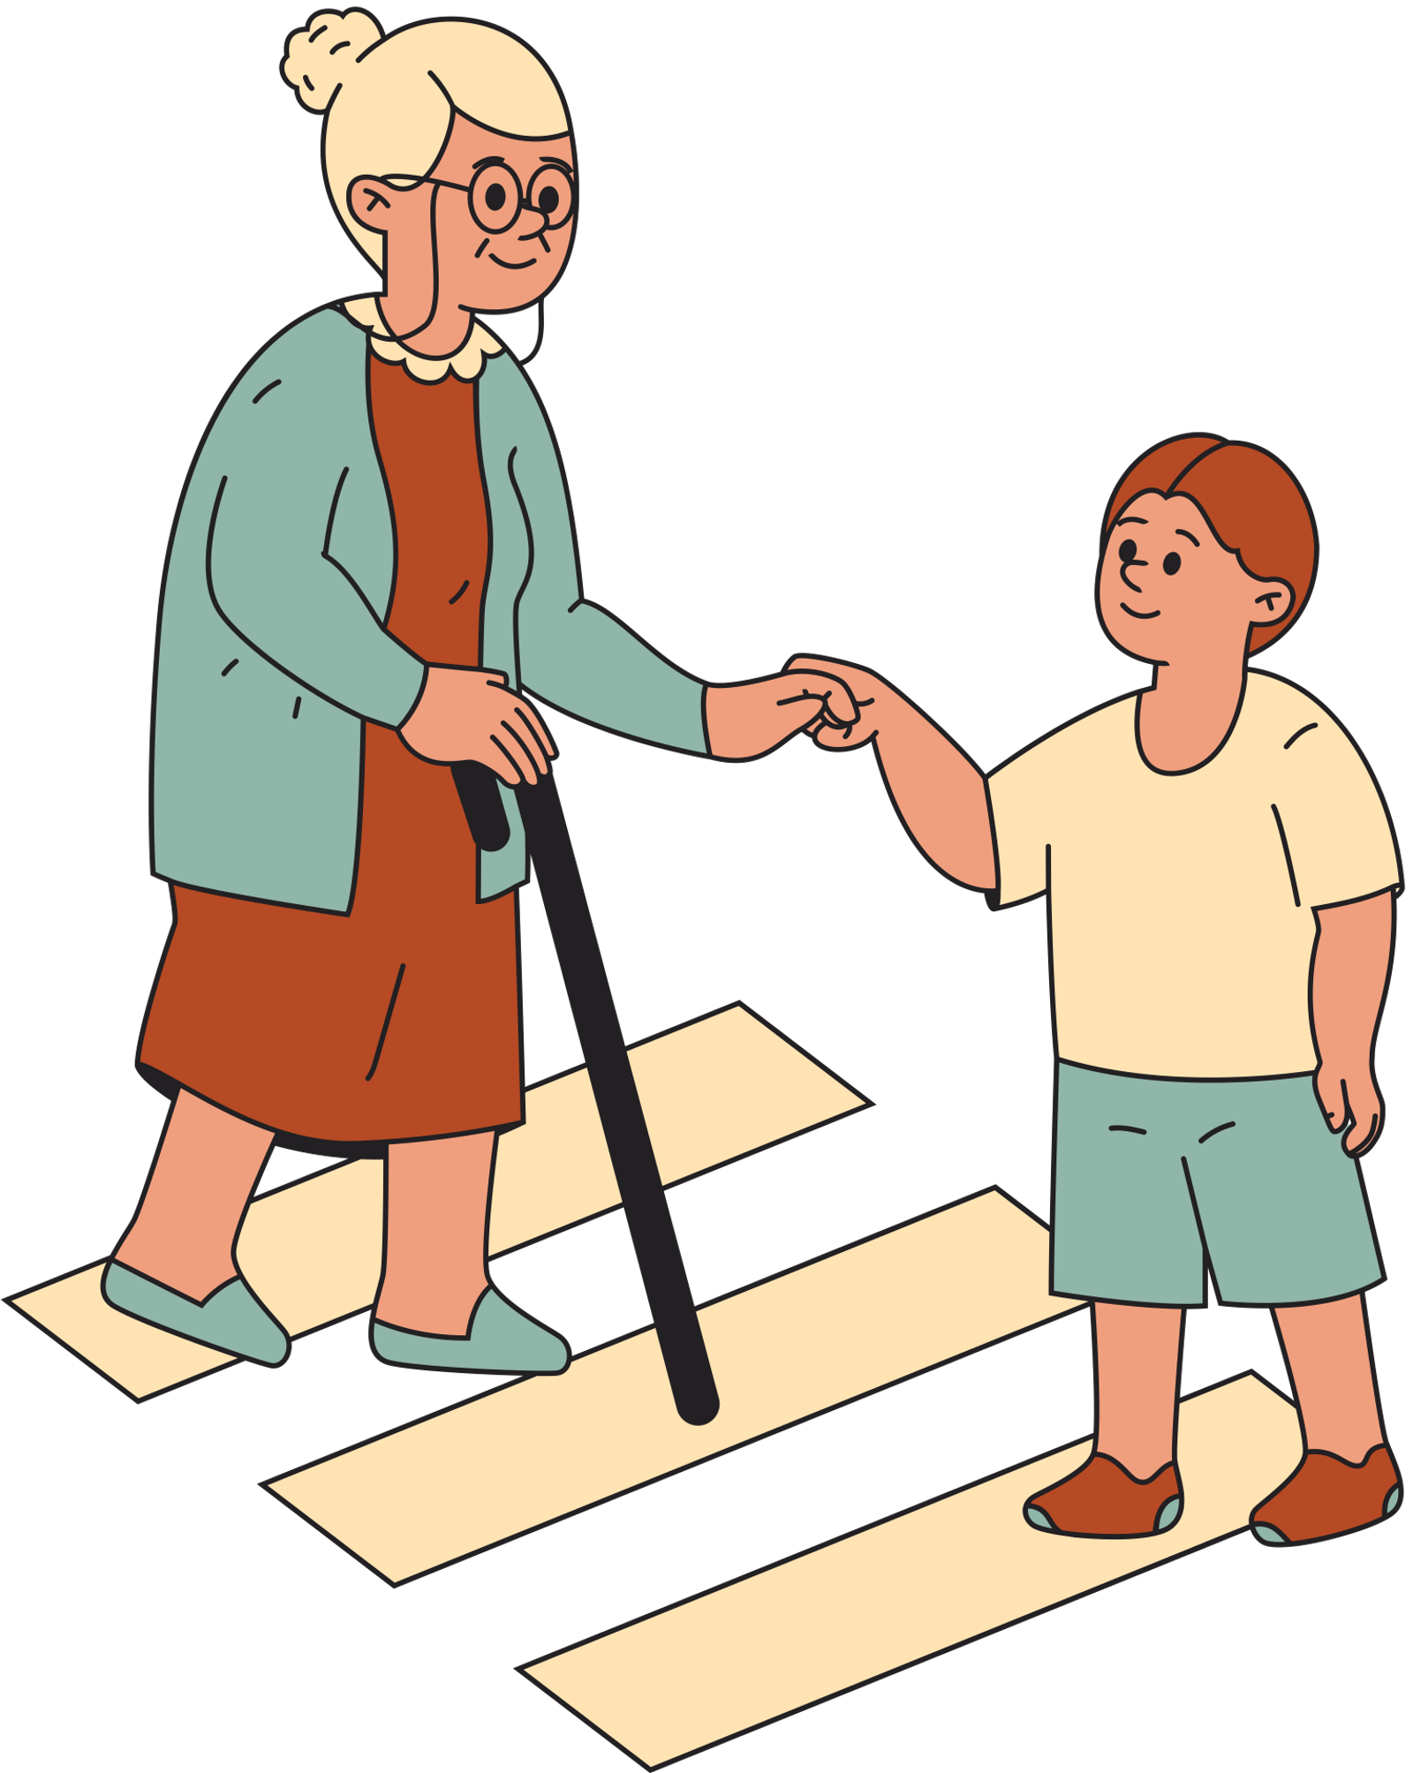
Part 1: Values & Stress
Week 6
Notes:
Designed and created by Dandi Yang. Do not duplicate or upload with the express written permission of the author.

Slide 2

Notes:
Before we begin, please feel free to open up this video, keep in the background and and enjoy some chill, lo-fi beats as you navigate through this lecture. Or watch the video in between work sessions to destress and refocus.

Slide 3

Overview
Defining Values
Values Clarification and Stress Management
Personal Values
Instrumental and Terminal Values

Slide 4
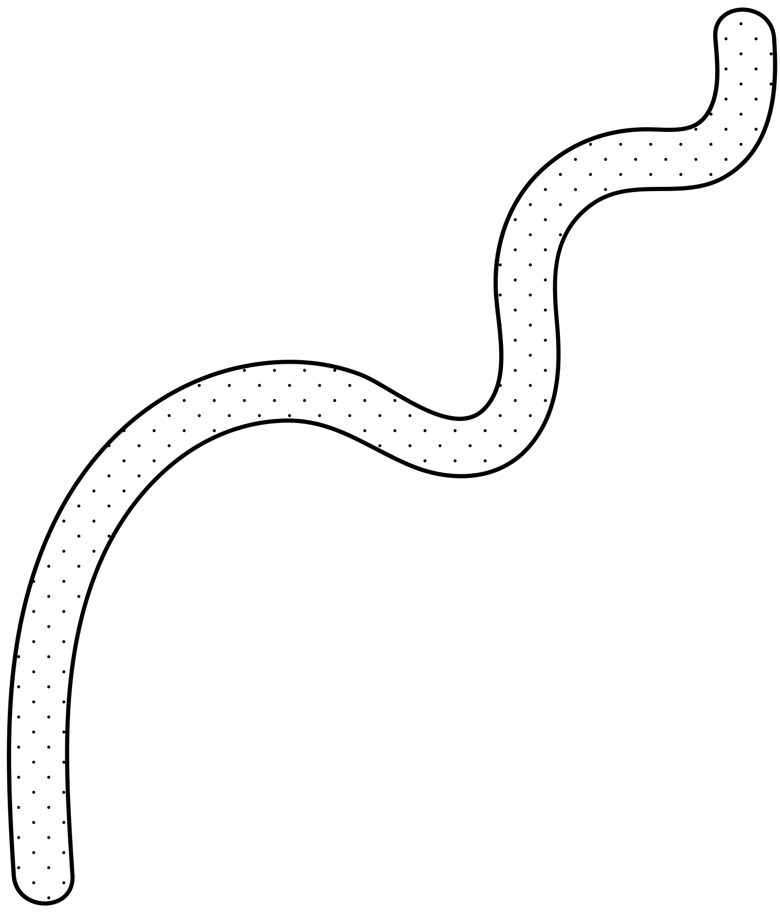
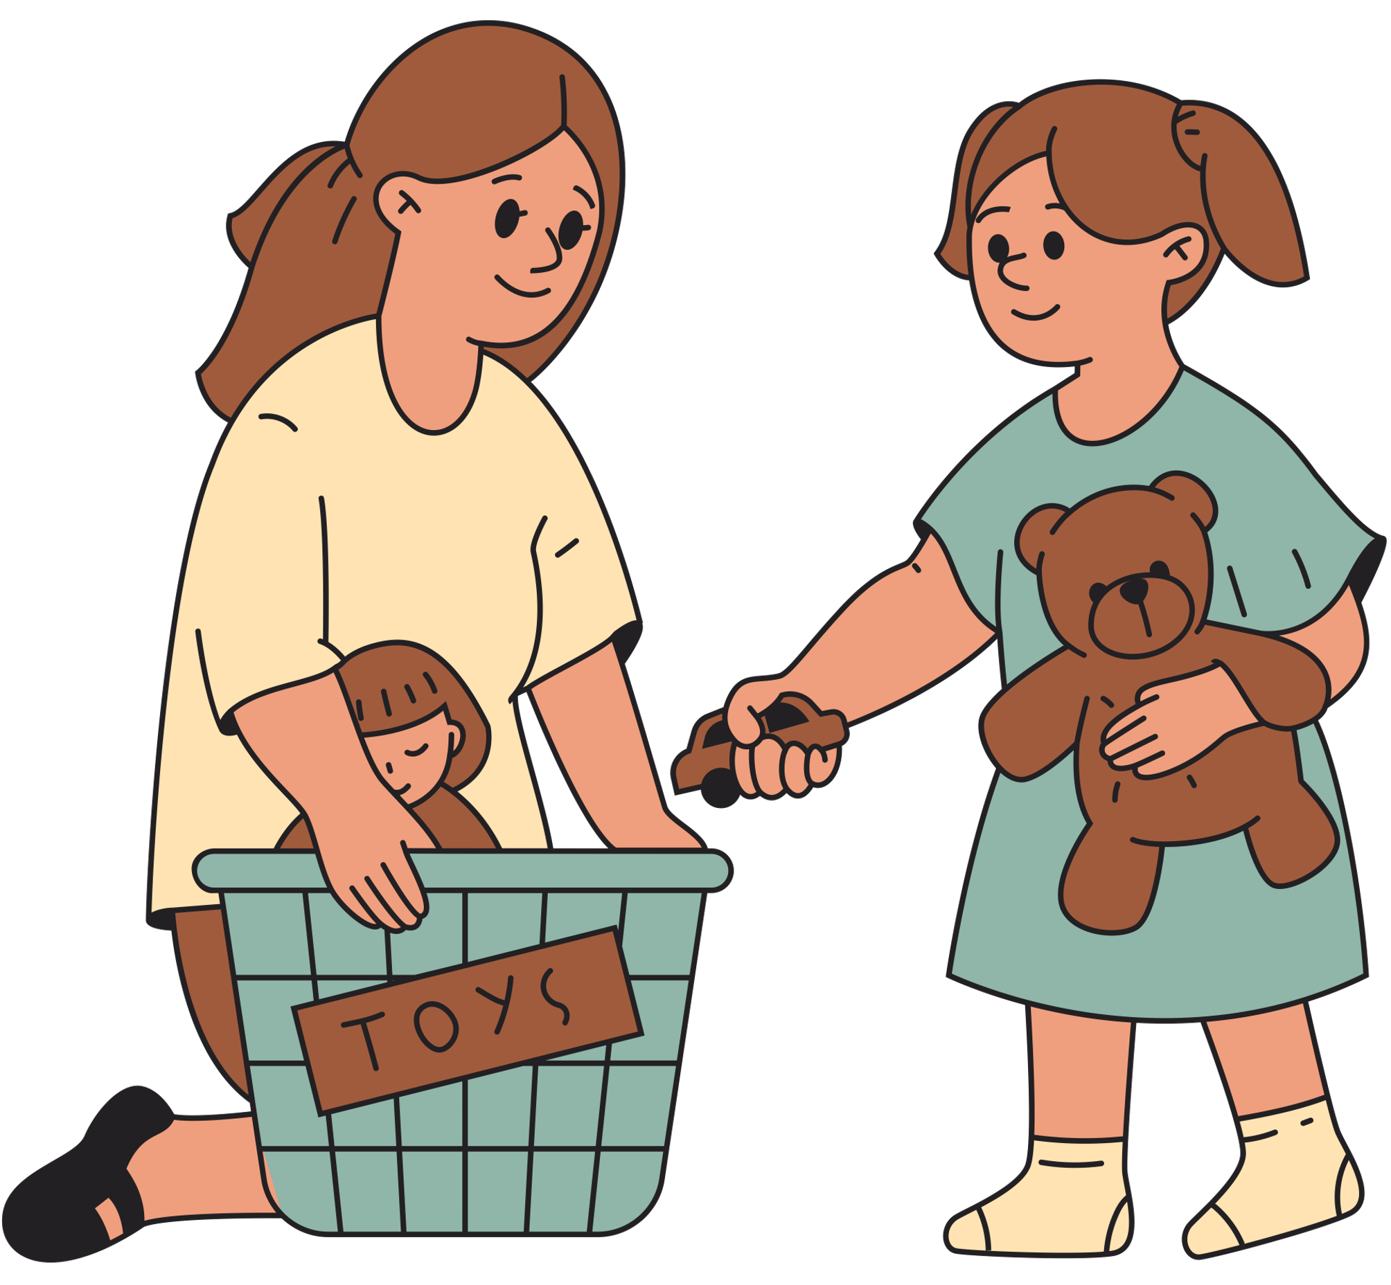


Value System
What a person is striving to achieve in life and how they want to behave
It helps you express who you are and what you stand for.
Notes:
A value can be defined as a belief upon which one acts by preference.
Values guide our actions and give direction and meaning to one’s life.
Decision-making comes down to how we value those things on which we are deciding. When you know what is most important to you, making the best decision is much easier. When you are unclear about what you value most, making the best decision is more difficult. The result is inner conflict and stress.

Slide 5

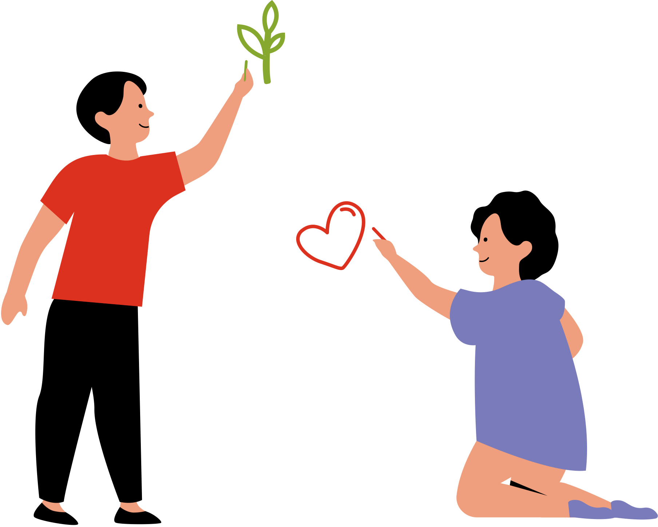

What is a value?
Qualities, characteristics, or ideas about which we feel strongly.
A belief or feeling that some or something is worthwhile.
Notes:
Our values affect our decisions, goals and behavior.
Values define what is of worth, what is beneficial, and what is harmful
Values are standards to guide your action, judgments, and attitudes.
If you are unaware of, or become disconnected with your values, you end up making choices out of impulse or instant gratification rather than on solid reasoning and responsible decision-making.

Slide 6



How Would You Spend Your Money?
You have been given a cheque for $5000 to do whatever you like with it.
What would you do with it?
How about a cheque of $10,000?
$100,000?
$1,000,000?
Is there a connection between your values and how you spend the money? What is it?
Does the connection change when you are given more money?
Notes:
We will all spend our money differently because we all have different core values. What you spend this free money on can indicate what is important to you, what you value, and what goals you are trying to achieve. Did you choose to buy something frivolous or practical? That can indicate whether you prioritize fun or security. Take a moment and think about what your spending choices say about what you value in life...
We don't necessarily need a situation like the one above to reveal our values, though. We can simply take a look at everyday decisions that we make, such as how we spend our time. Think about what you did in the past week. What you choose to do with your time has everything to do with what you value. Did you spend a lot of time working? Perhaps money, security or social recognition is high on your list of values...

Slide 7



More about values
Values give direction and consistency to behaviour.
Values help you know what to and not to make time for.
Values establish a relationship between you and the world.
Values set the direction for one’s life.
Notes:
As you can see, personal values are connected to almost every facet of one’s self. By knowing your values, you can find clarity in the decisions you make, the emotions you feel and how you see yourself.

Slide 8
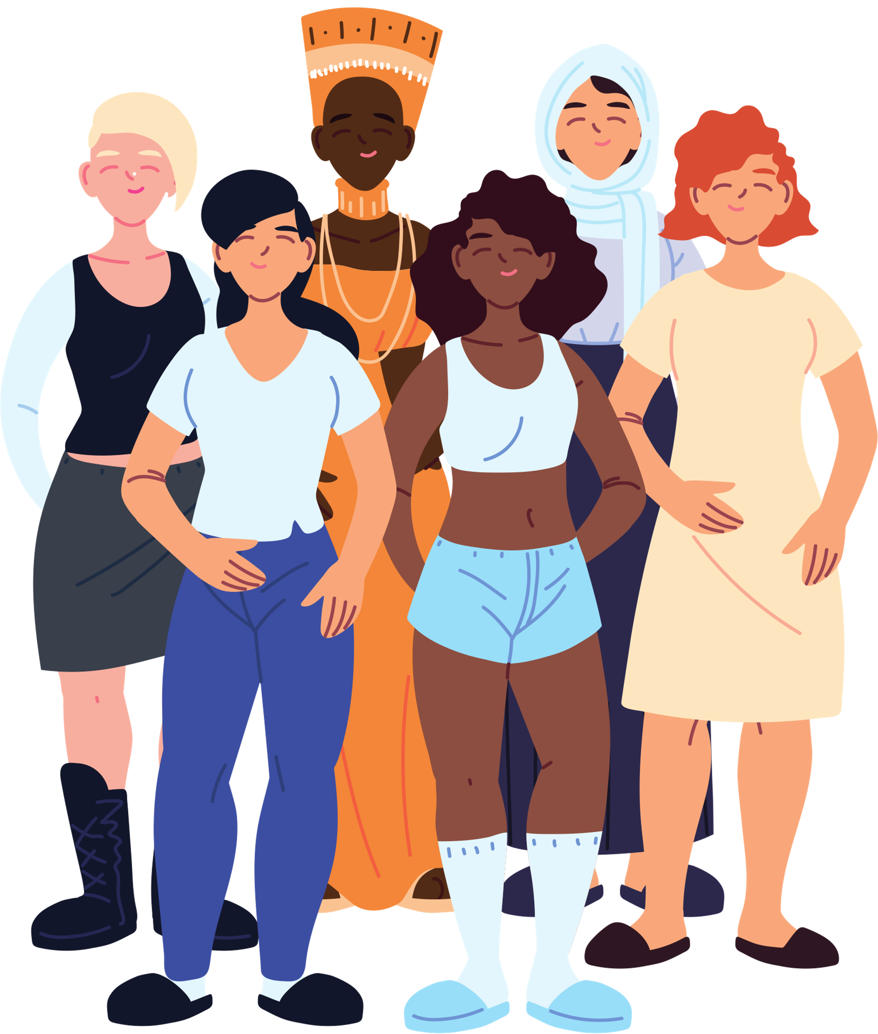
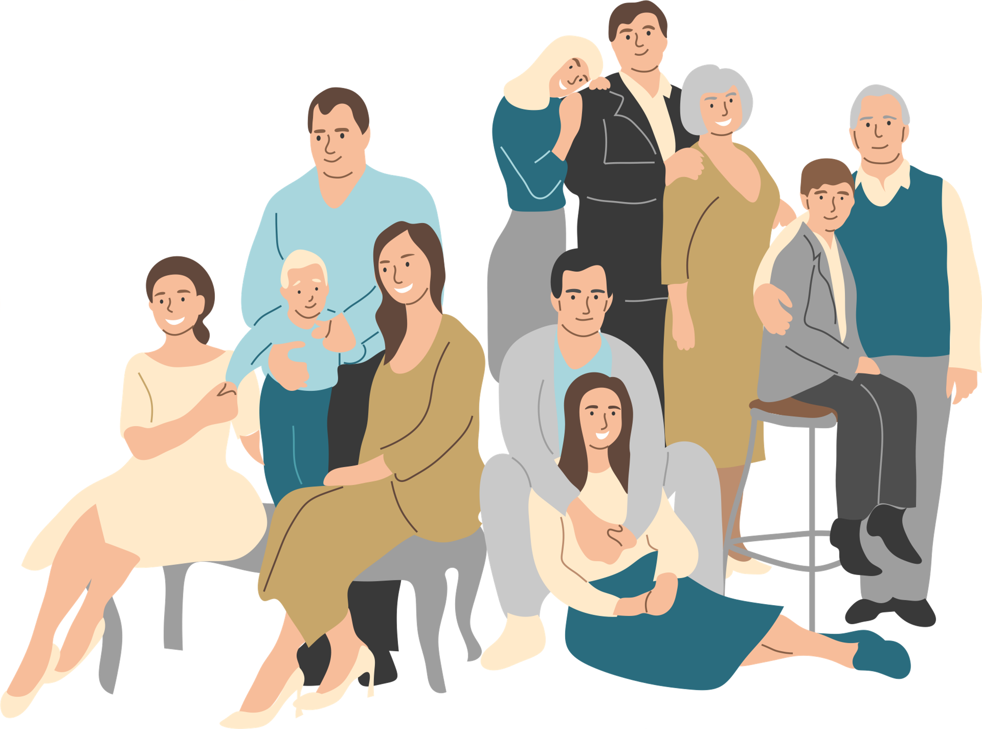
Where Do We Get Our Values?
Our homes
School
Society
Friends
TV
Religions
Music
Books
Families
Culture
Employers
Time-period in which you were raised
Notes:
Our current time-period focuses on equality for all. In the past, values such as health and fitness, peace and individuality were ones that were emphasized.

Slide 9
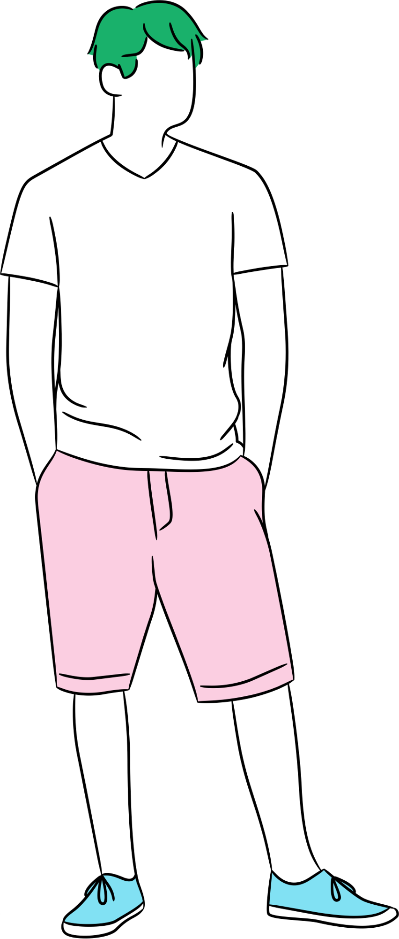
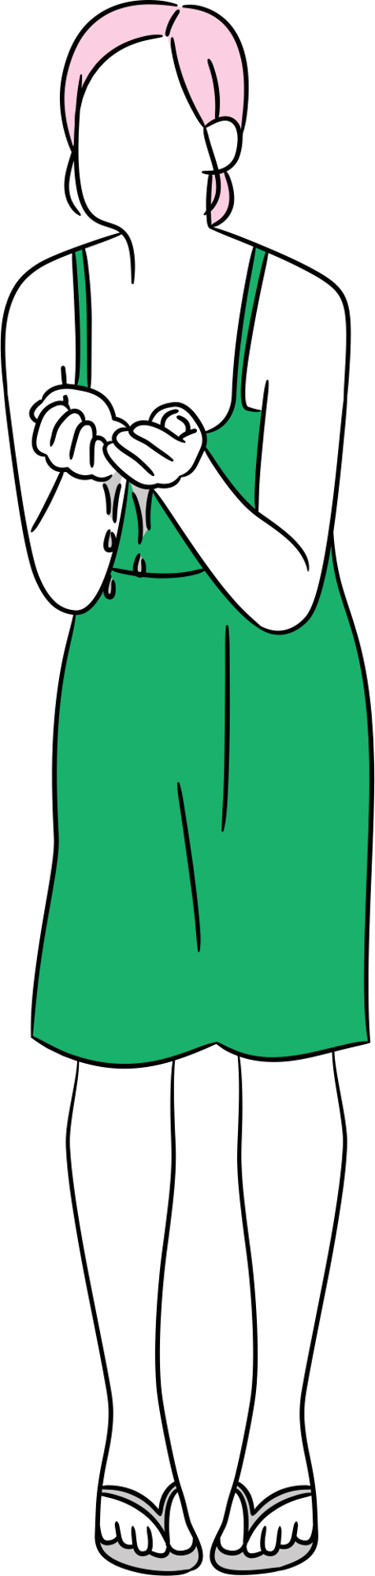
Age and Values
Your age will greatly influence your values. Different people and things influence you at different ages
Ages 1-7 - parents
Ages 8-13 - teachers, idols (athletes, influencers, other celebrities)
Ages 14-20 - friends (values from your friends or friends because of similar values?)
Ages 21+ your values are established, but you may test your values from time to time.
Notes:
Values come from all aspects of society with which we interact: culture, family, school, work, religion, media. Thus, the society you are raised in can greatly influence the kind of values you are exposed to. In North America, for instance, people who were raised in the 70's were often exposed to messages that were anti-establishment, pro-peace and focused on individuality. While those raised in the 90's may have been more influence by messages that concerned the Earth, Green Peace, health & fitness.
Your age also greatly influences your values. Different people and things influence you at different ages.

Slide 10
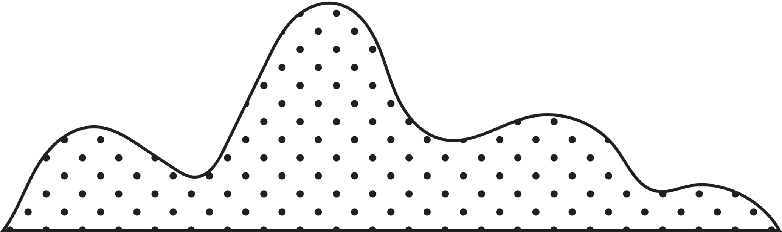

Values vs. Facts
Values are things we feel “should”, “ought”, or “are supposed to” influence our lives.
VALUE: People should donate blood to help others
VALUE: The best time to buy clothing is when the price is discounted.
A value is a statement of one’s personal beliefs.
Facts simply state what actually exists, is based in truth and can be proved with the scientific method.
FACT: Only 4% of Canadians donate blood
FACT: The most economical time to buy clothing is when thasons change and the price is reduced
A fact is established by observation and measurement.

Slide 11
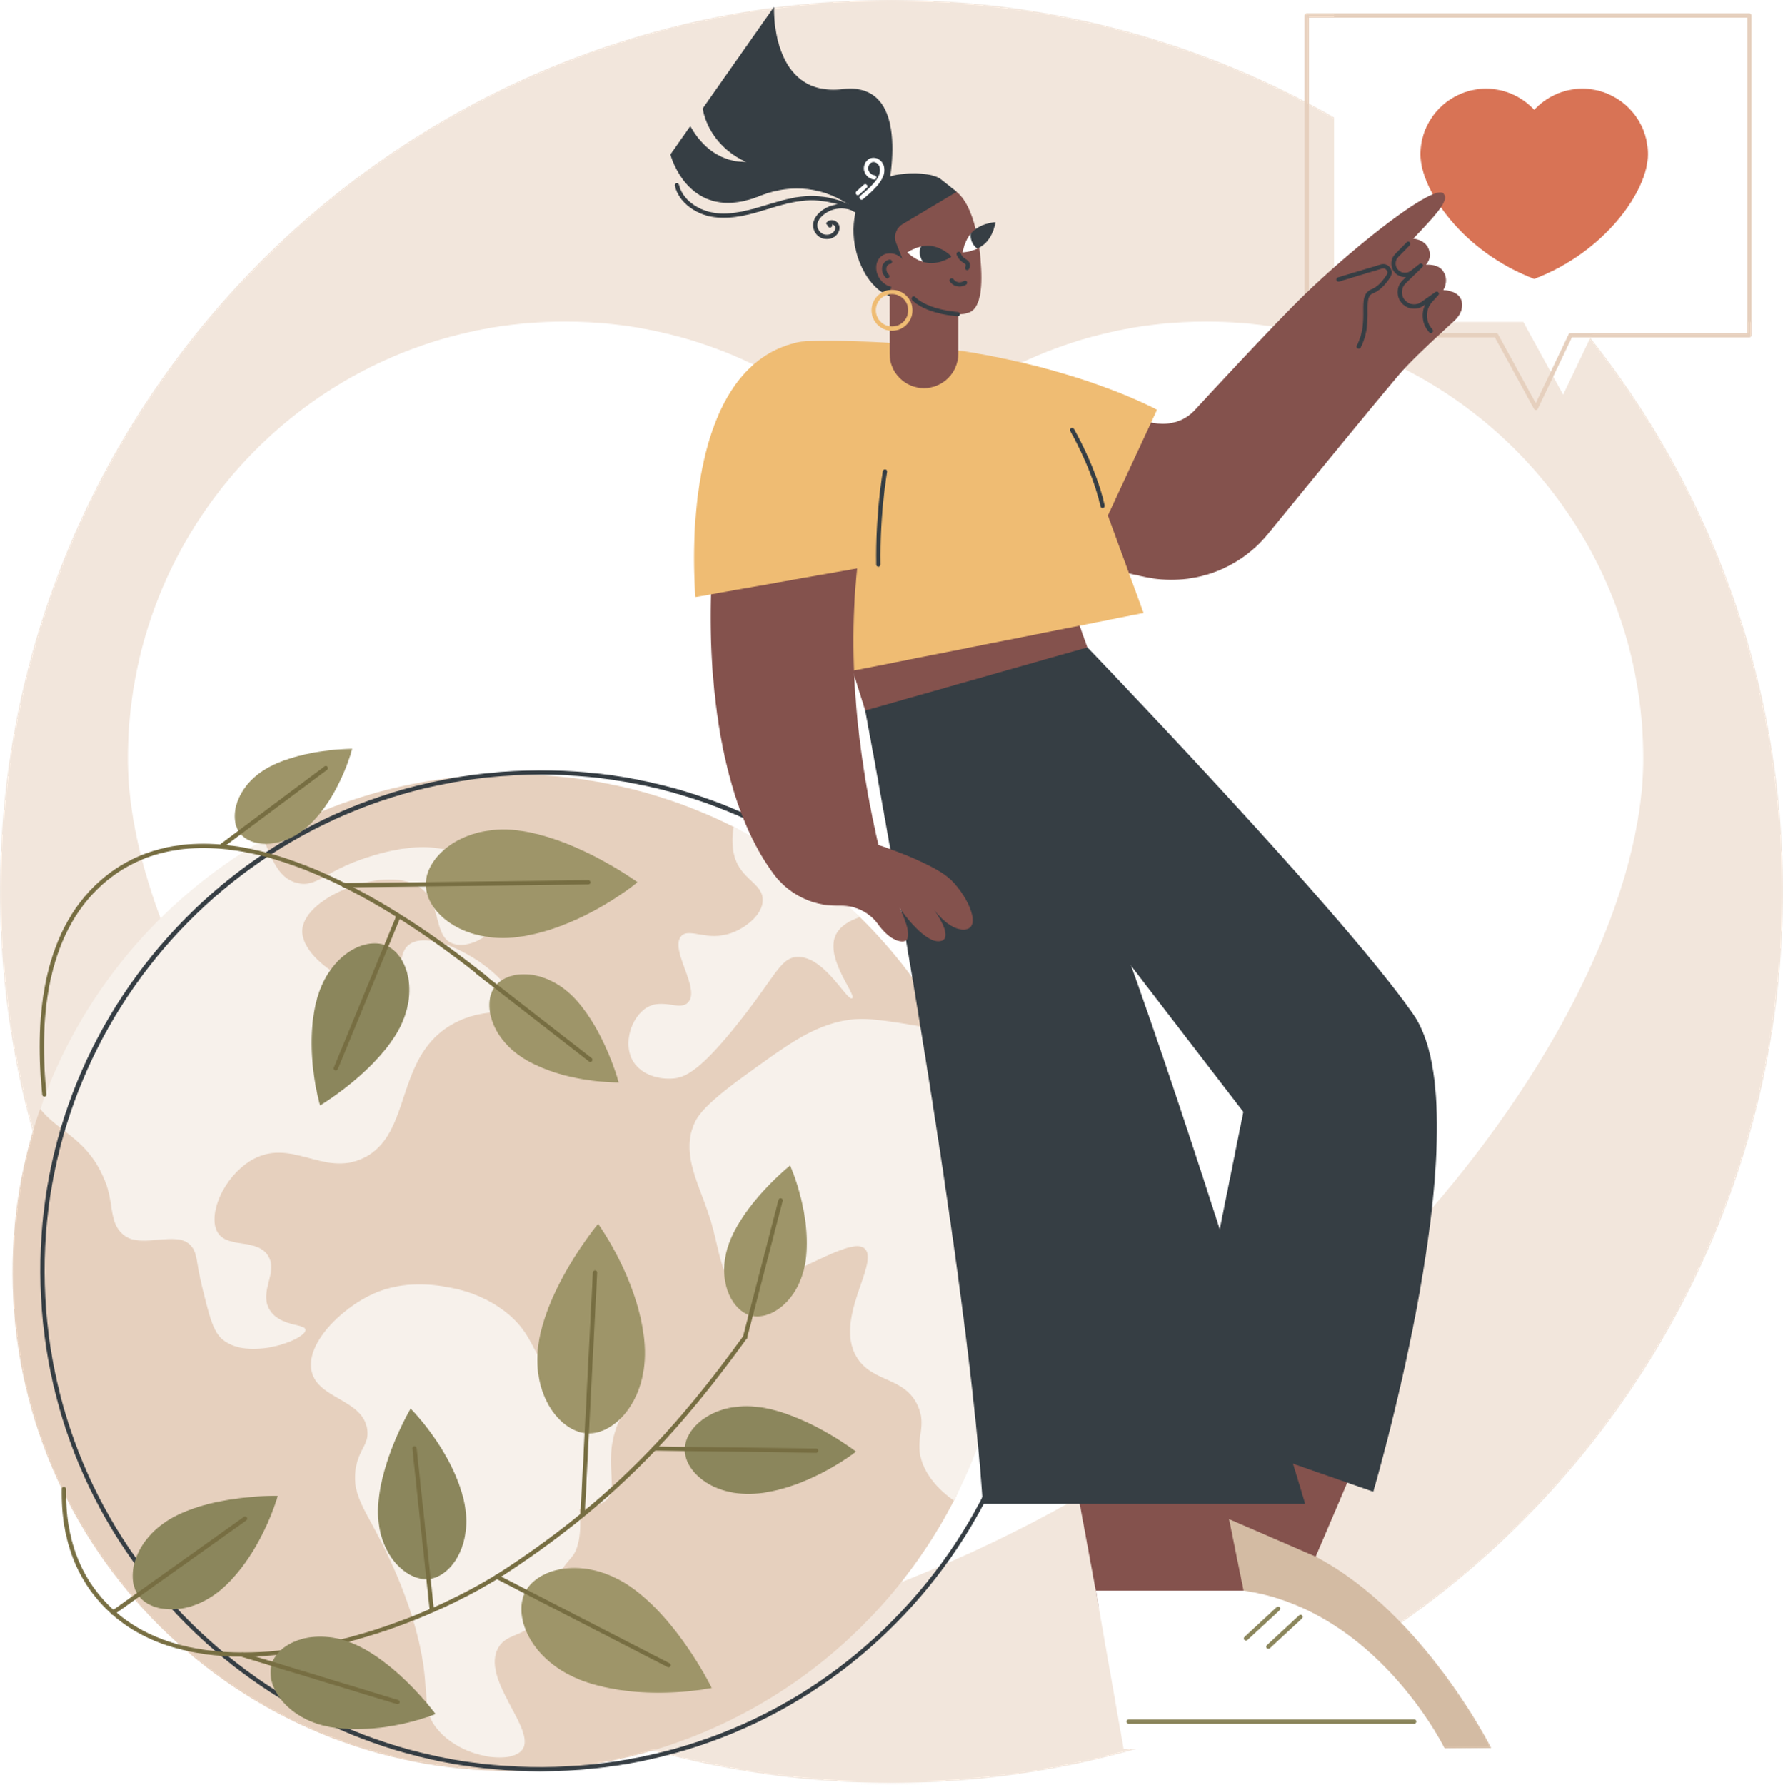
Examples of Values
Social
Equality, justice, liberty, freedom
Personal
Honesty, responsibility, loyalty
Family
Quality time, patience, compassion
Career
Cooperation, productivity, creativity
Notes:
Social values are those which put the rights of wider groups of people first.
Personal values are those traits we see as worth aspiring to, and that define our character.
Family Values - To love and care for those we are close to; our children, our parents, other family members, and our friends.
Career Values - The best use and expression of our talents and skills for the purposes of contributing to society and for monetary compensation.

Slide 12
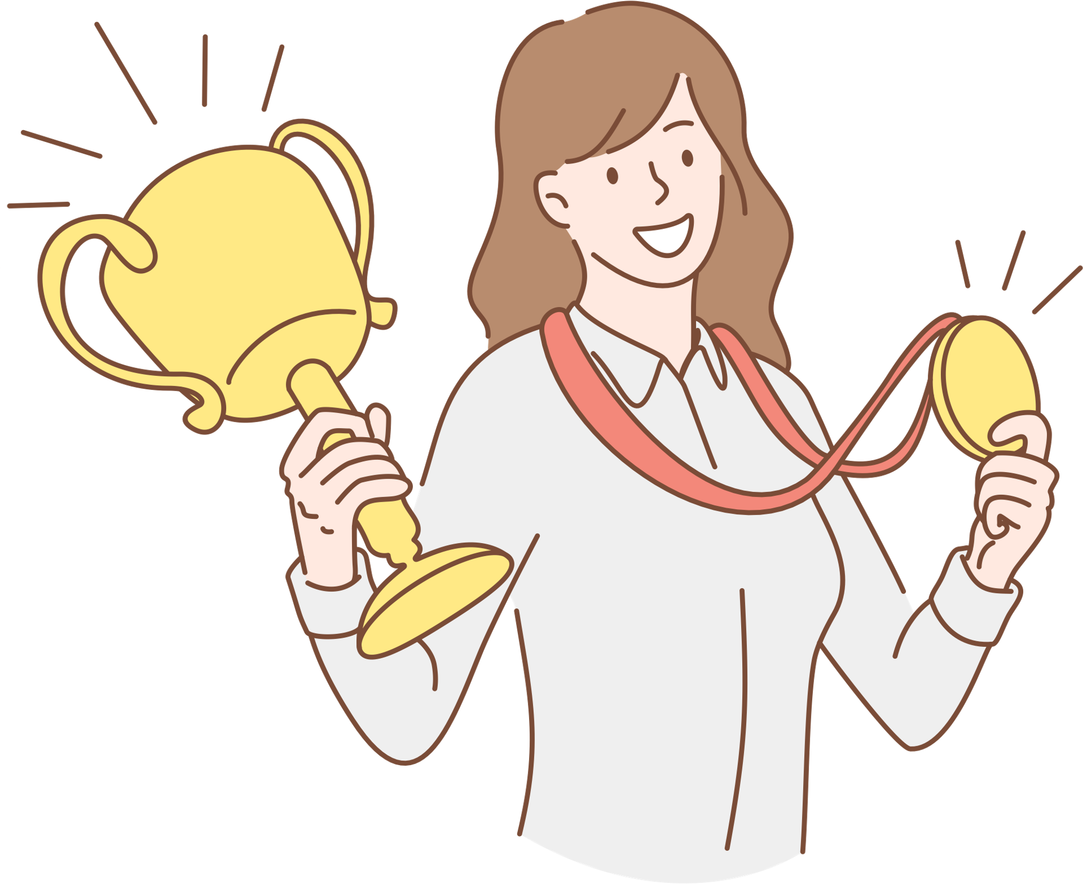
Terminal and Instrumental Values
Terminal Values
A personal conviction about life-long goals
Signify what an individual is trying to accomplish
Instrumental Values
A personal conviction about desired modes of conduct or ways of behaving
Guide the ways in which the individual achieves individual goals
Notes:
Terminal Values: A personal conviction about life-long goals. They are outcomes that one works toward or believes are most important and desirable; end states of feeling. Often signify what an individual is trying to accomplish.
Instrumental Values: A personal conviction about desired modes of conduct or ways of behaving. They are values that consist primarily of personal characteristics and character traits that tend to lead toward terminal values. Signifies how an individual will achieve their end goals.

Slide 13
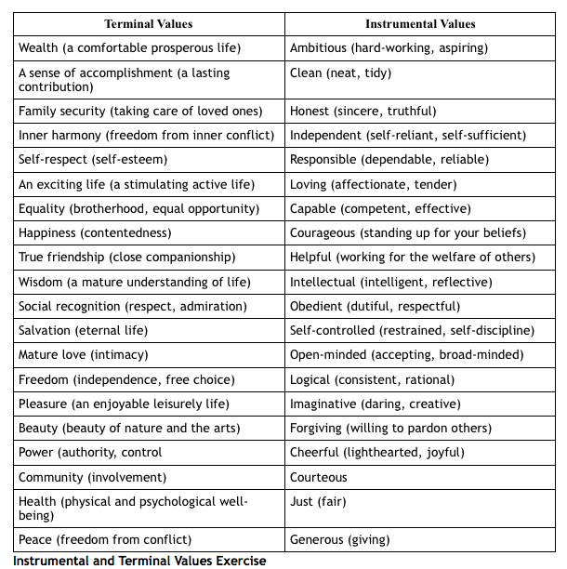

Slide 14
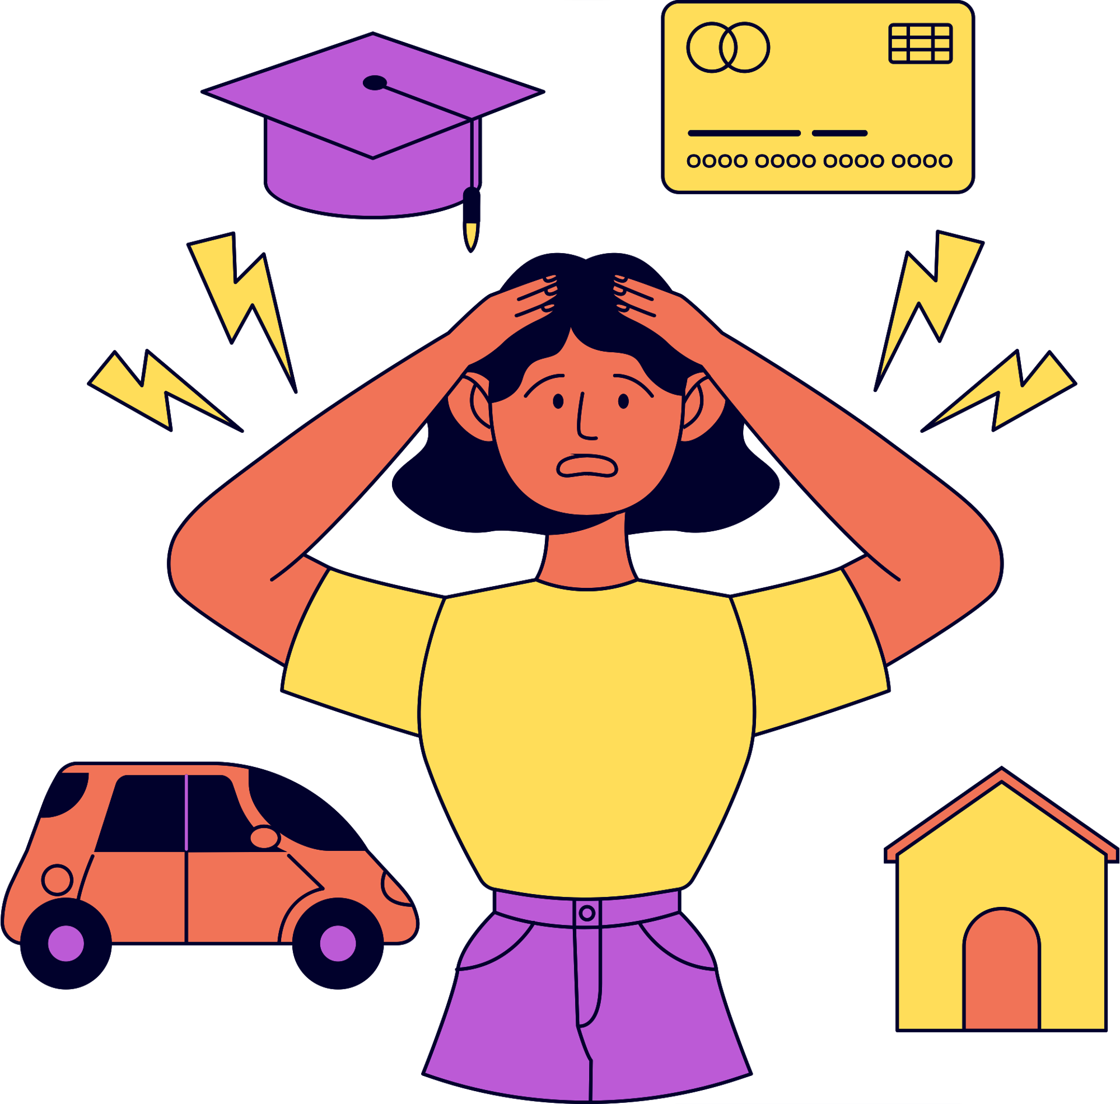
Personal Values and Stress
Often if our actions don’t line up with our values, it creates feelings of stress
Sometimes our values and goals aren’t our own, but comes from expectations or inherited from others
Values from other sources (school, parents, friends etc.) may or may not reflect what is meaningful to you
Your values and goals change, and reevaluating and reconsidering your values from time to time is important.
Notes:
Clarifying your values and attitudes is an important first step in moving toward developing a stress-resilient philosophy of life. The greater the congruence between your values and your goals, and between your decisions and actions, the lower your stress level. Think of your values and attitudes as your roadmap in life. The better the map, the smaller the chance that you may make a wrong turn.
At various points in life, you realize that some of your values and goals are not providing you with the kind of happiness and satisfaction you want. Many of your core values may not be the values you truly believe in. They may be values you inherited from others, without much thought on your part.
These values can come from your parents, your peers, your religion, your teachers, television and the movies, the corporation or organization you work for, or the community you live in. Such values can match your own values. However, in some cases, they may not reflect what is truly meaningful or important to you at this point in your life.

Slide 15
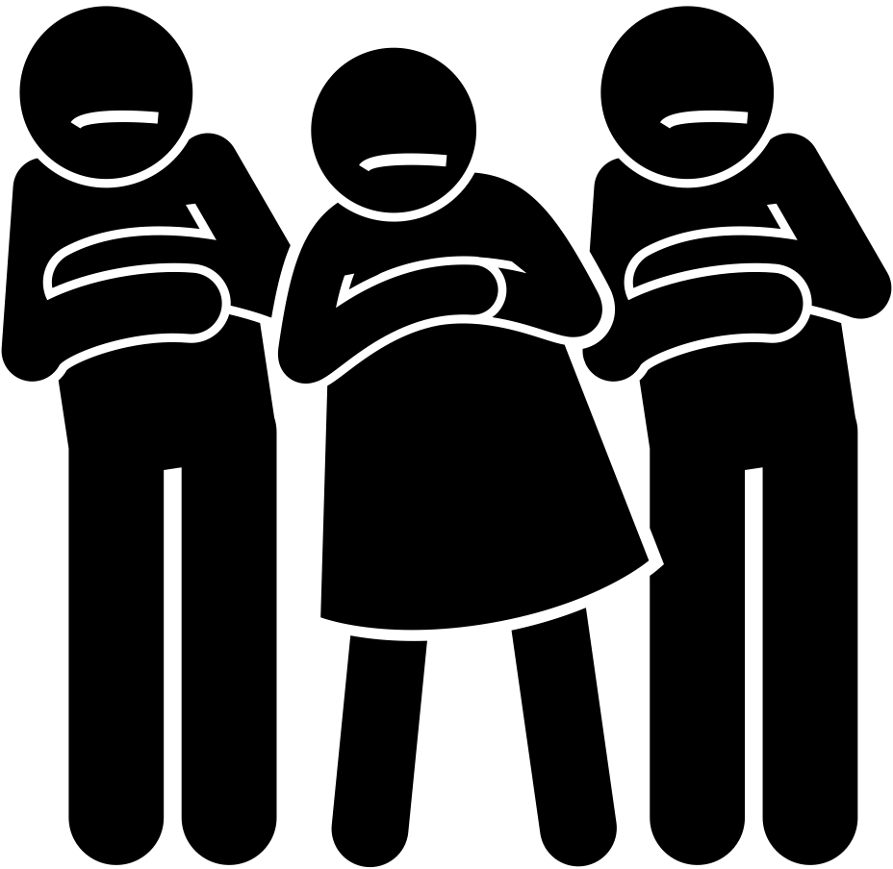
Personal Values and Stress
Hypocrite – one who subscribes to one set of values, and does another.
Value Immaturity - one who has not identified their values.
Unclear values
Drifters
Flighty
Uncertain
Apathetic
Notes:
Value Maturity
Clear values
Life of purpose
Meaning and direction
When you don’t reach these goals, or fulfill these needs and wants, you feel stressed

Slide 16
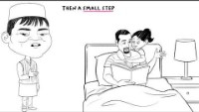
Notes:
https://www.youtube.com/watch?v=Ky3Z_b9q1Ts
Acting on your values to manage stress better In this video, we learn how even the hardest or most stressful of times, focusing on value-based actions, can give us a sense of purpose and meaning.

Slide 17
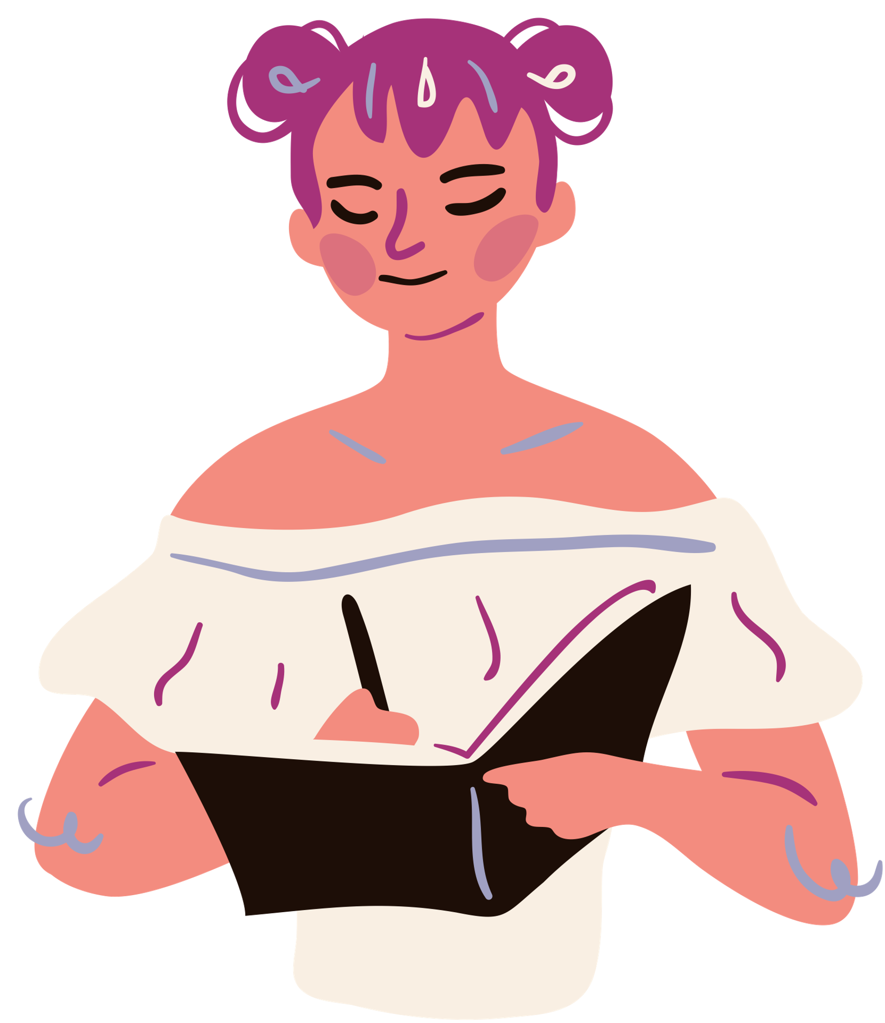
Value Research
A group of Stanford students were asked to write about their most important personal values and then describe how the events of each day connected with them. Another group was simply asked to describe the positive events that happened throughout their day.
Researchers discovered that the students who wrote about their personal values were healthier, experienced fewer illnesses, and had better energy and attitude.
Notes:
In the short term, writing about personal values makes people feel more powerful, in control, proud, and strong. It also makes them feel more loving, connected, and empathetic toward others. It increases pain tolerance, enhances self-control, and reduces unhelpful rumination after an experience that resulted in stress.
In the long term, writing about personal values has been shown to boost test scores, reduce doctor visits, improve mental health, and help with everything from weight loss to quitting smoking and reducing problem drinking. It helps people persevere in the face of discrimination and reduces self-handicapping.

Slide 18
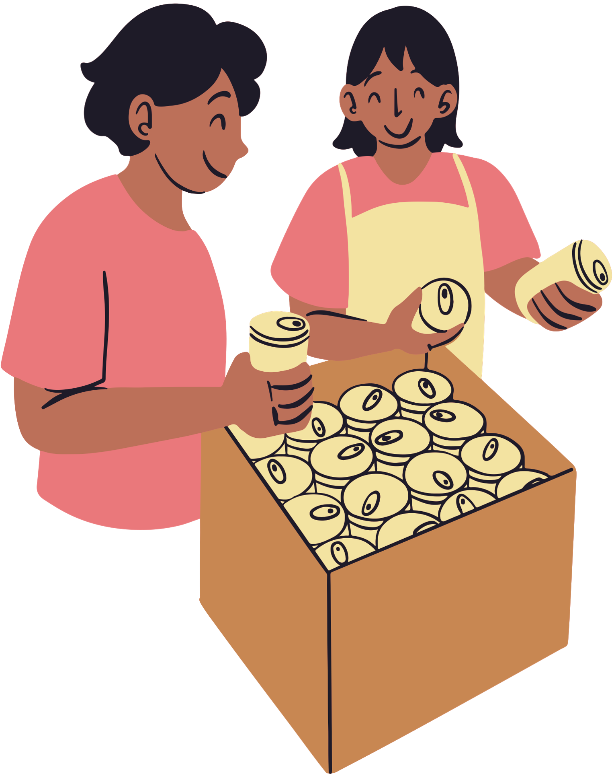
Using Personal Values
Taking personal values and connecting them to the events in your life helps to reveal the meaning behind stressful events in your life.
Stressful experience can be become moments of meaning
Notes:
Writing about how our day-to-day actions match up with our deepest personal values can mentally and biologically improve our ability to deal with stress.Stressful experiences were no longer simply hassles to endure; they became an expression of the students' values… small things that might otherwise have seemed irritating became moments of meaning.

Slide 19
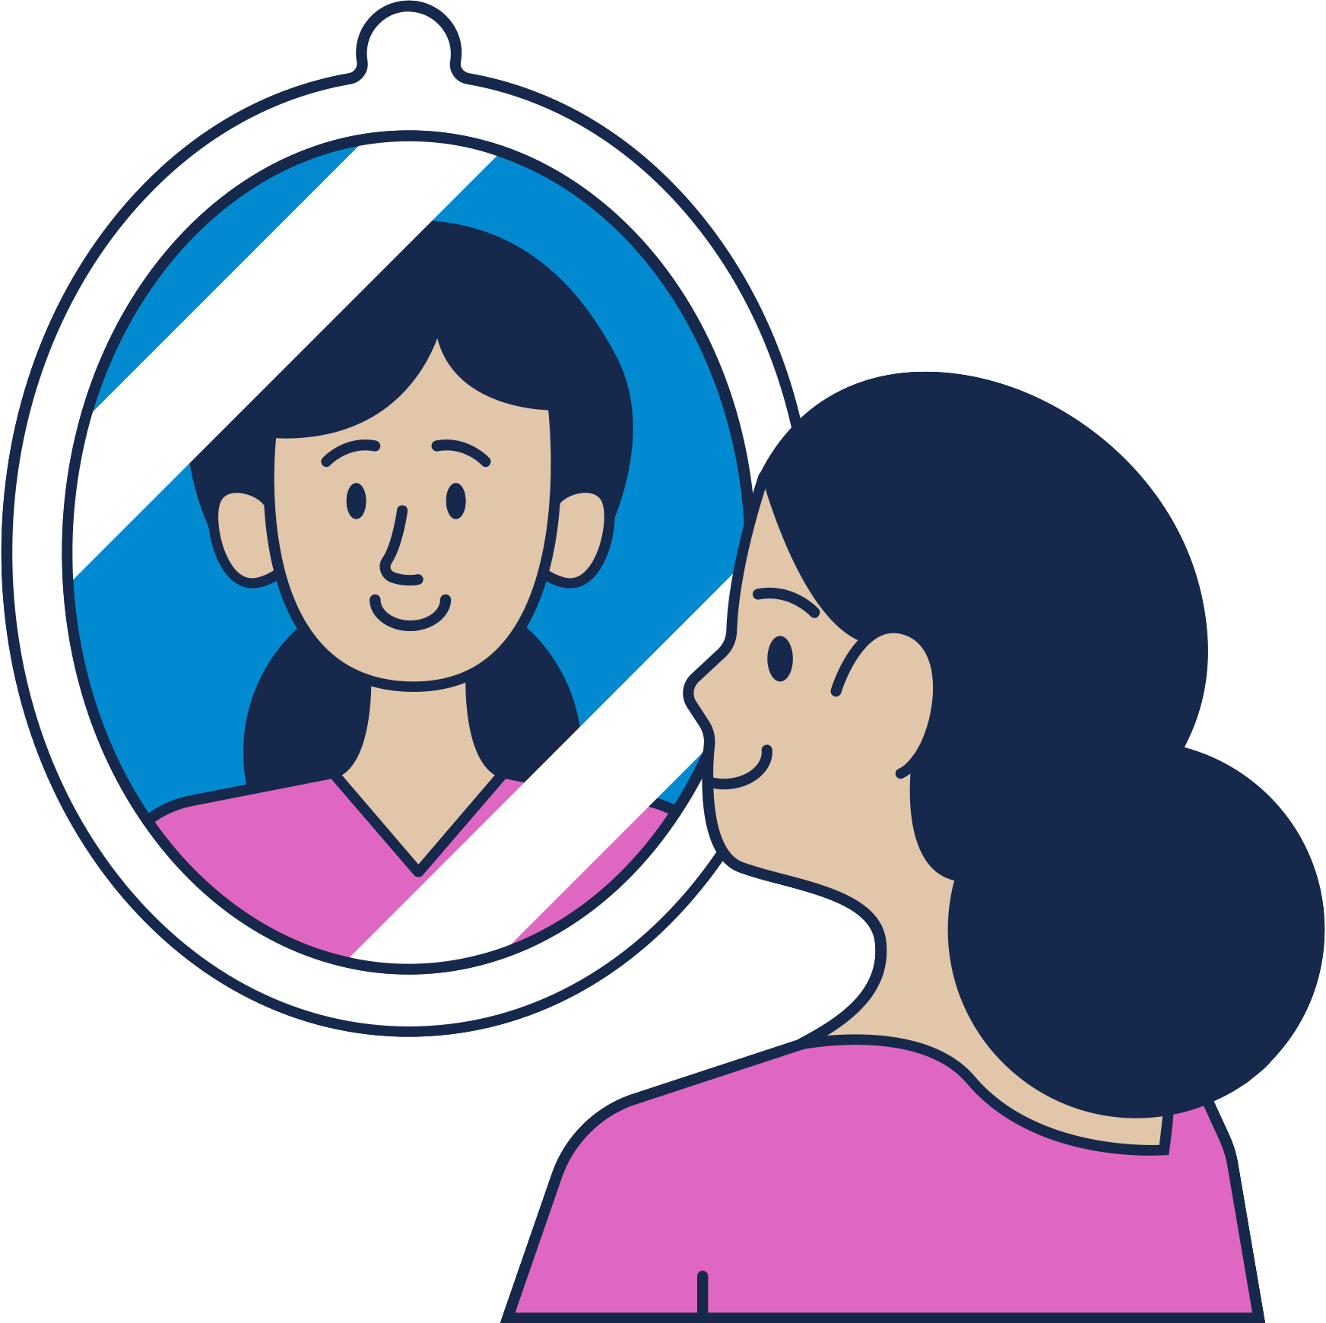
Reflecting on your values
Journaling
Writing and recording your thoughts
Thinking regularly during a daily mundane activity
While brushing your teeth, on your commute
During important moments when you are proud or happy
Notes:
When you can, reflect back over the choices you’ve made and the values you have labeled. Here you’re trying to identify authentic vs inauthentic values. Consider which choices were comfortable and easy. Which choices left you feeling satisfied? These choices were most likely guided by genuine values. Were there any choices that left you feeling uncomfortable? Did any choices have an uneasy hangover to them? If they did they may have been guided by inauthentic values or you may have been making compromises on these choices.
Collect and list all of the values that fit you. The list can be as long or as short as you like. Look at the list and consider which values feel like priorities right now. Why is living by these values the priority? Are they the most helpful at getting you closer to the goals you’ve set? Are any of these values consistently being unmet? Are there any situations where you feel a value is being compromised or where you feel conflicted?

Slide 20
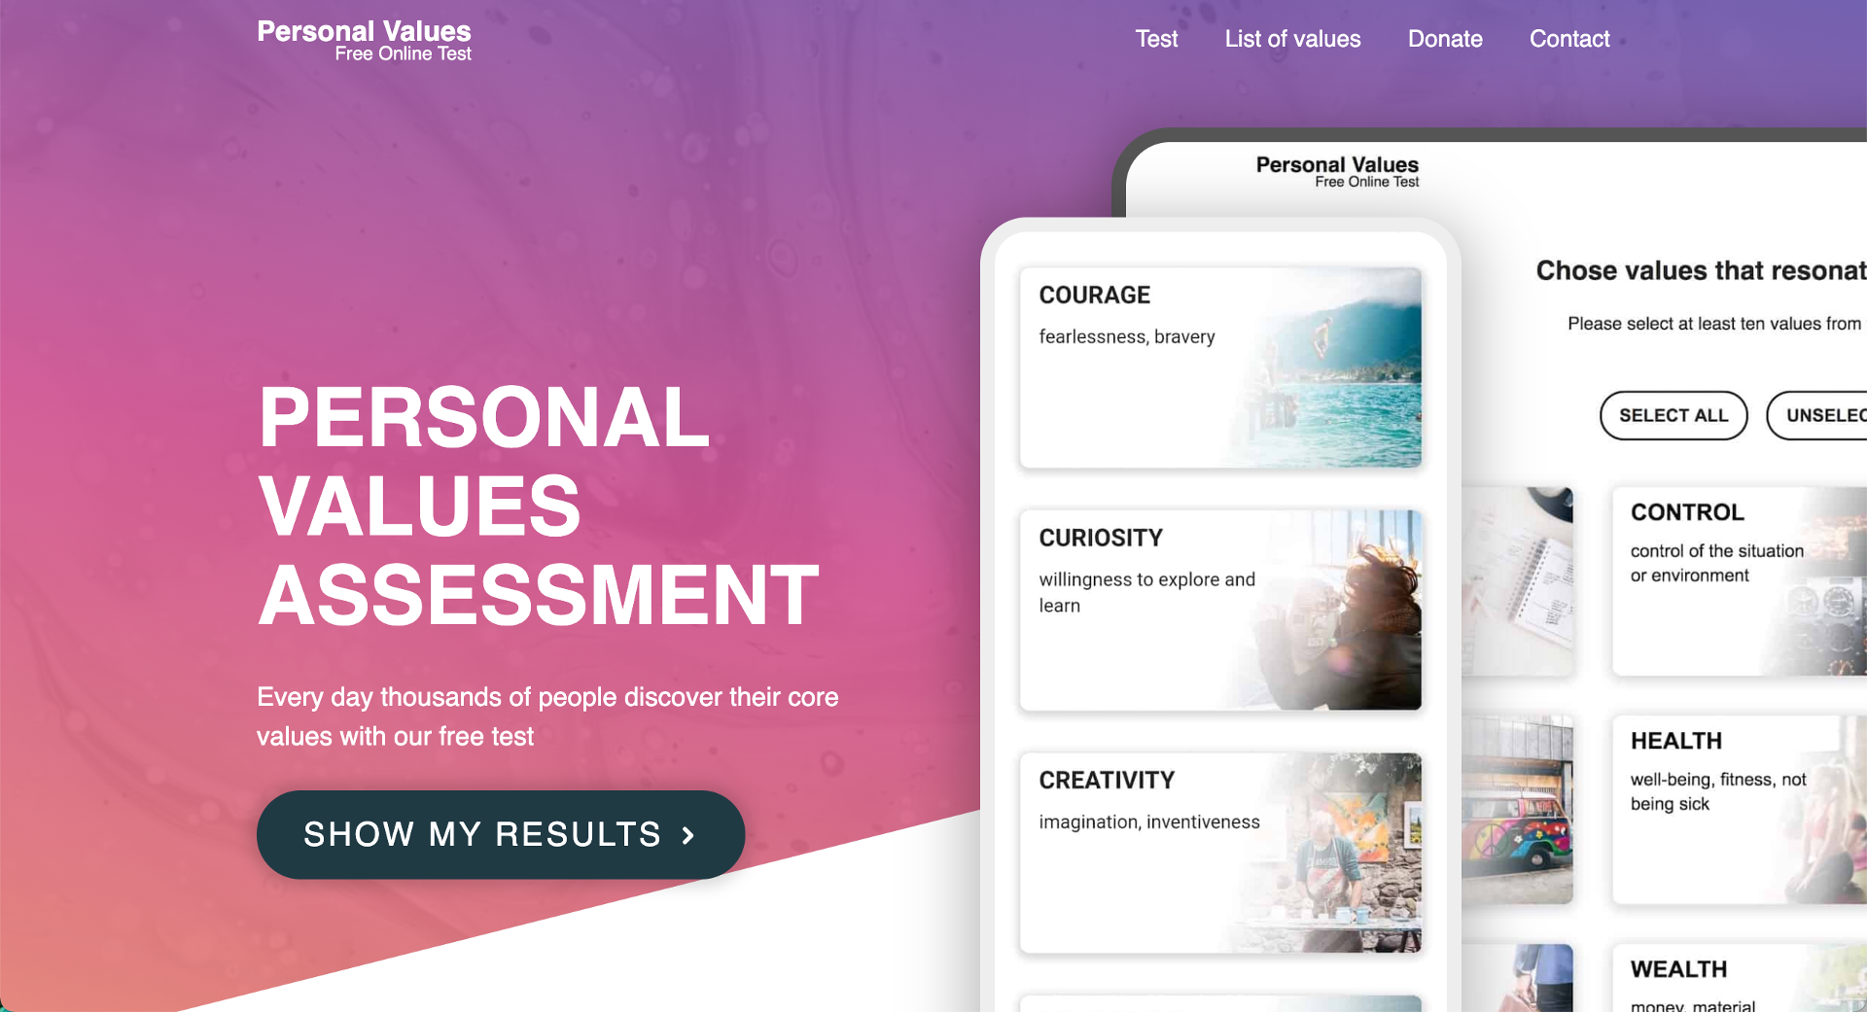
Notes:
Go to https://personalvalu.es/
to find out what your personal values are

Slide 21
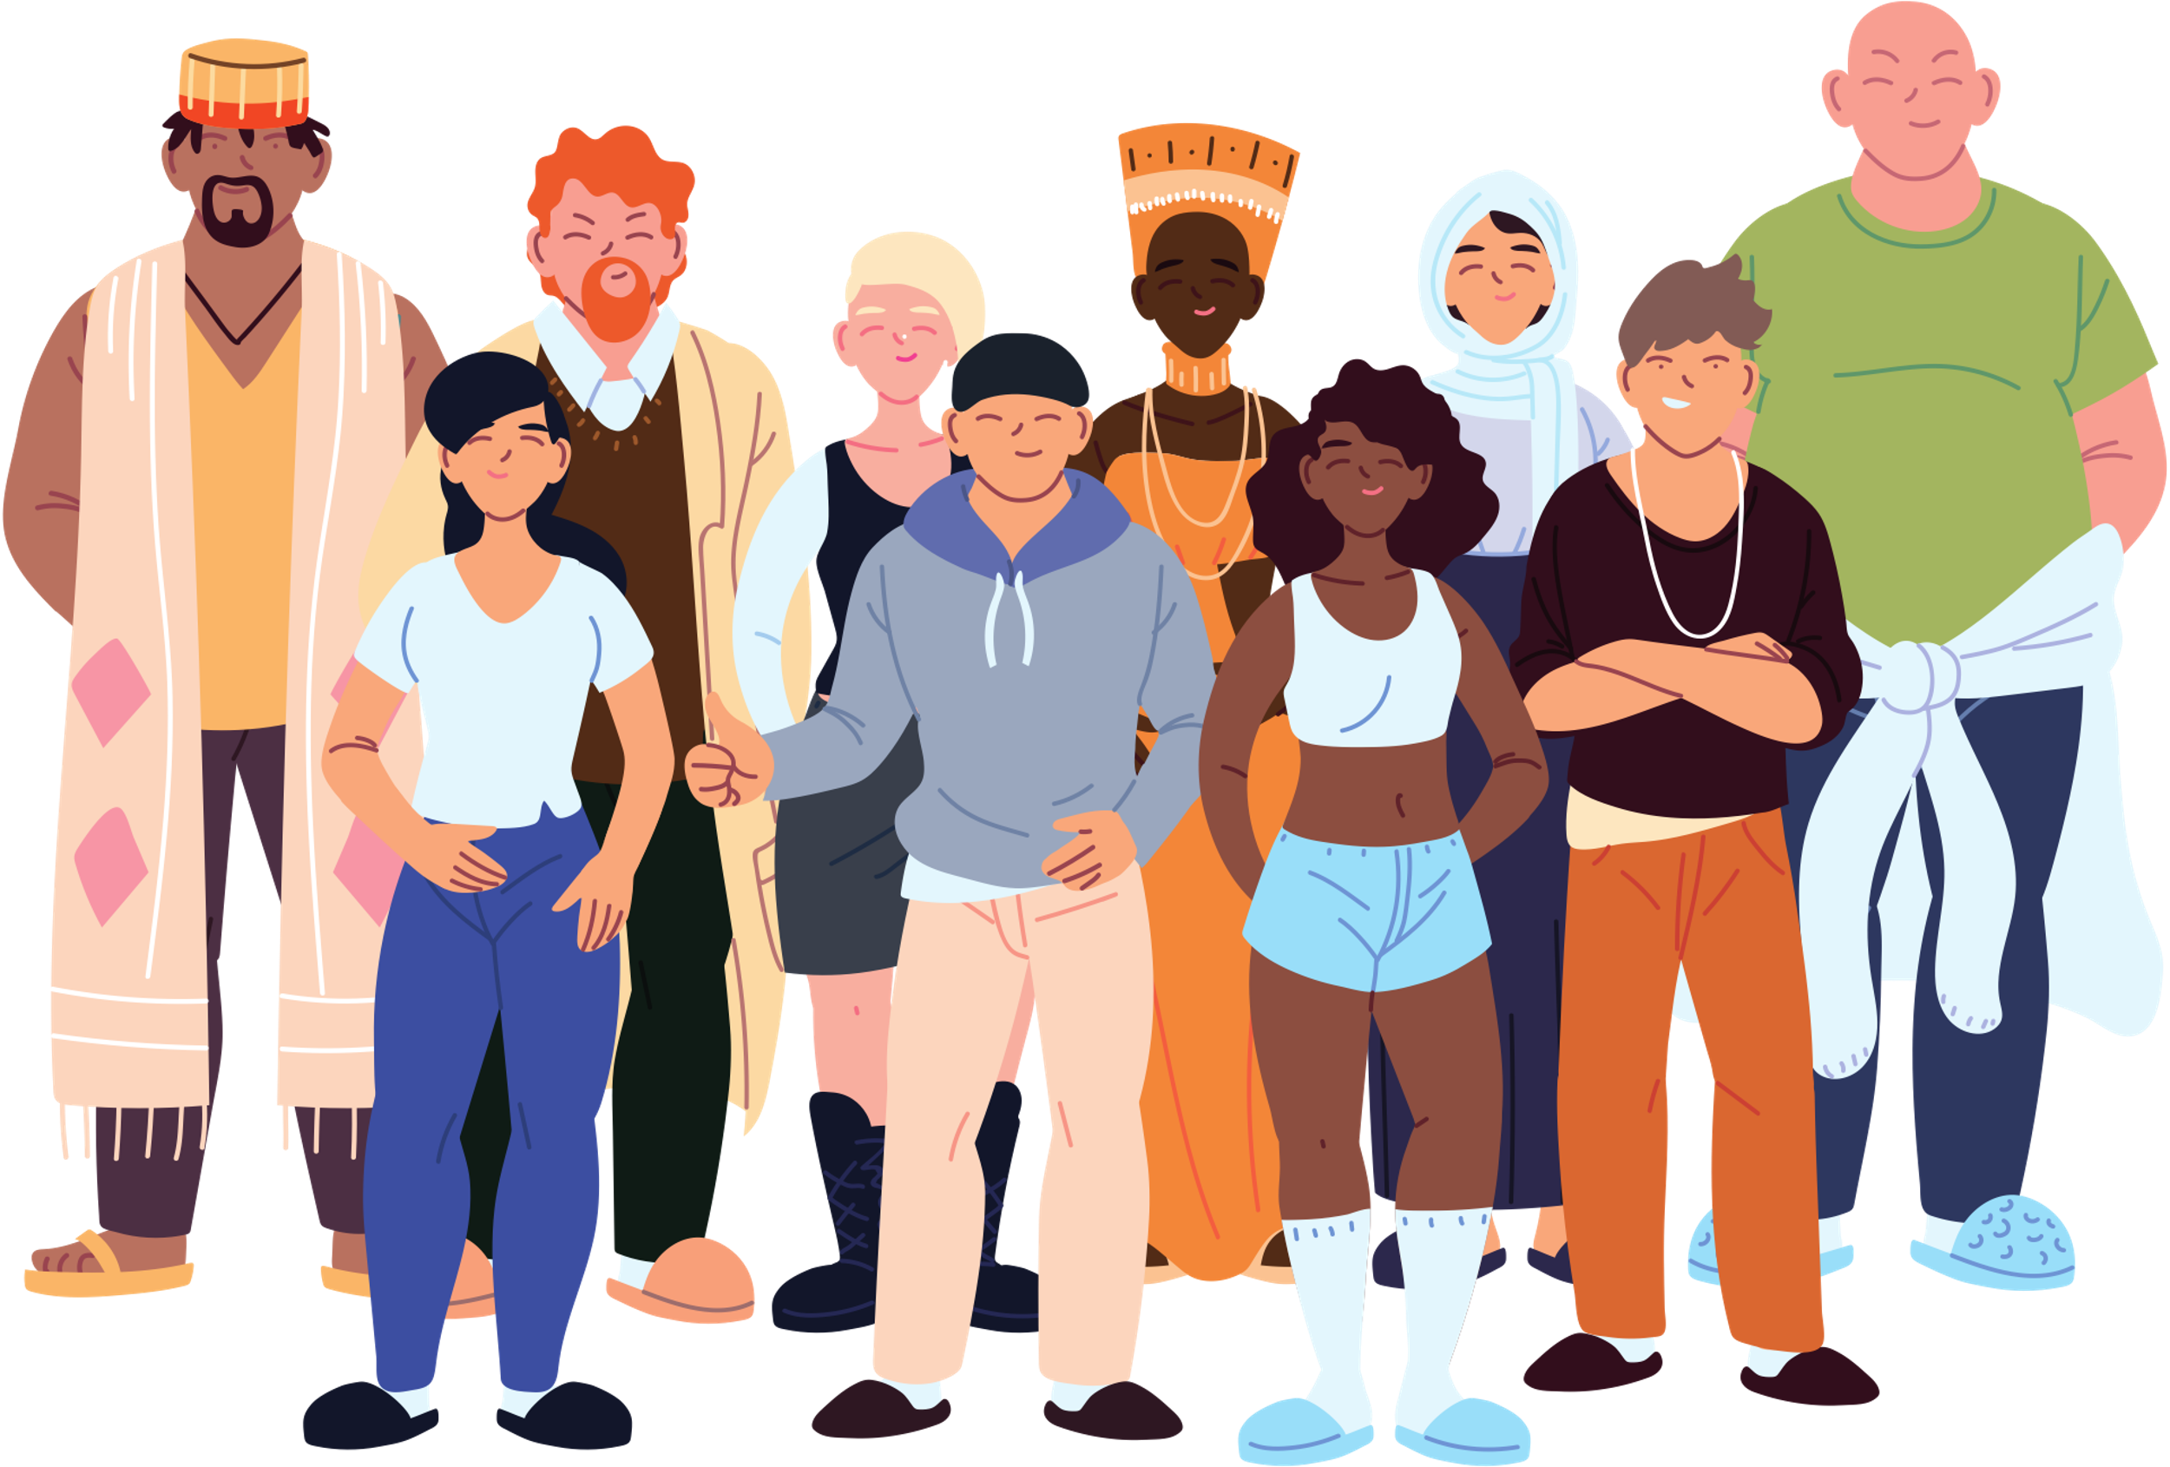
Part 2: Diversity & Stress
Lecture 5
Notes:
Note: There appears to be a lack of data and research on the role of race or visible minority status on health in Canada. Consequently, it makes it difficult for researchers and policy makers to easily answer questions about visible minorities and health. I tried my best to include most information from Canadian demographics and research, although the textbook will include information from US sources.

Slide 22
Overview
Defining Racialized Stress and Its Causes
Health Status Differences
Indigenous Peoples’ Health
Socioeconomic & Educational Level and Stress
Reducing Health Disparities
Notes:
This chapter considers the relationship between diversity and stress. We consider such factors as health, poverty, education, and family structure as they relate to race and ethnicity, cultural background, gender, age, sexual orientation, and disabilities.

Slide 23
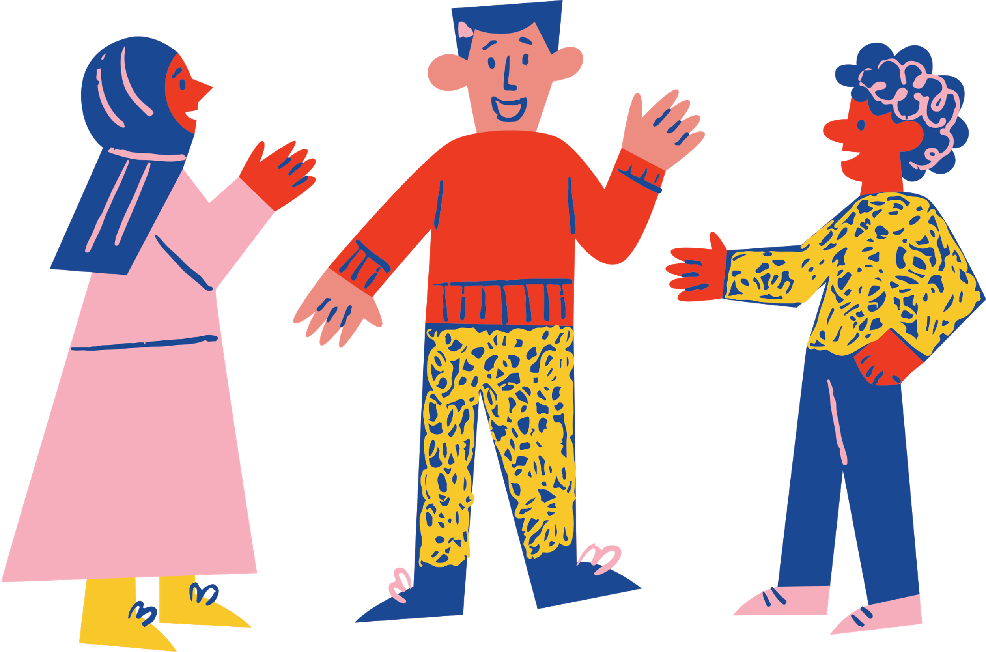
Definitions
Minority Group: A category of people who experience relative disadvantage as compared to members of a dominant social group.
Marginalized populations: Groups and communities that experience discrimination and exclusion because of unequal power relationships
Notes:
Minority group membership is typically based on differences in observable characteristics or practices, such as: ethnicity (ethnic minority), race (racial minority), religion (religious minority), sexual orientation (sexual minority), or disability.
Marginalization, also called social marginalization, occurs when a person or groups of people are less able to do things or access basic services or opportunities.
Are you able to send your kids to good schools, and are they free or affordable? If you become ill, is it easy for you to see a doctor and get treatment? Do you have the same chances as everyone else to get a job and build a career? Schools, access to healthcare, employment—these are all areas where people may not have equal opportunities, and this causes marginalization. But marginalization can also come from everyday inequalities, like whether you live in an area with good, safe roads or access to public transit, or if buildings are equipped for a disability you might have.

Slide 24
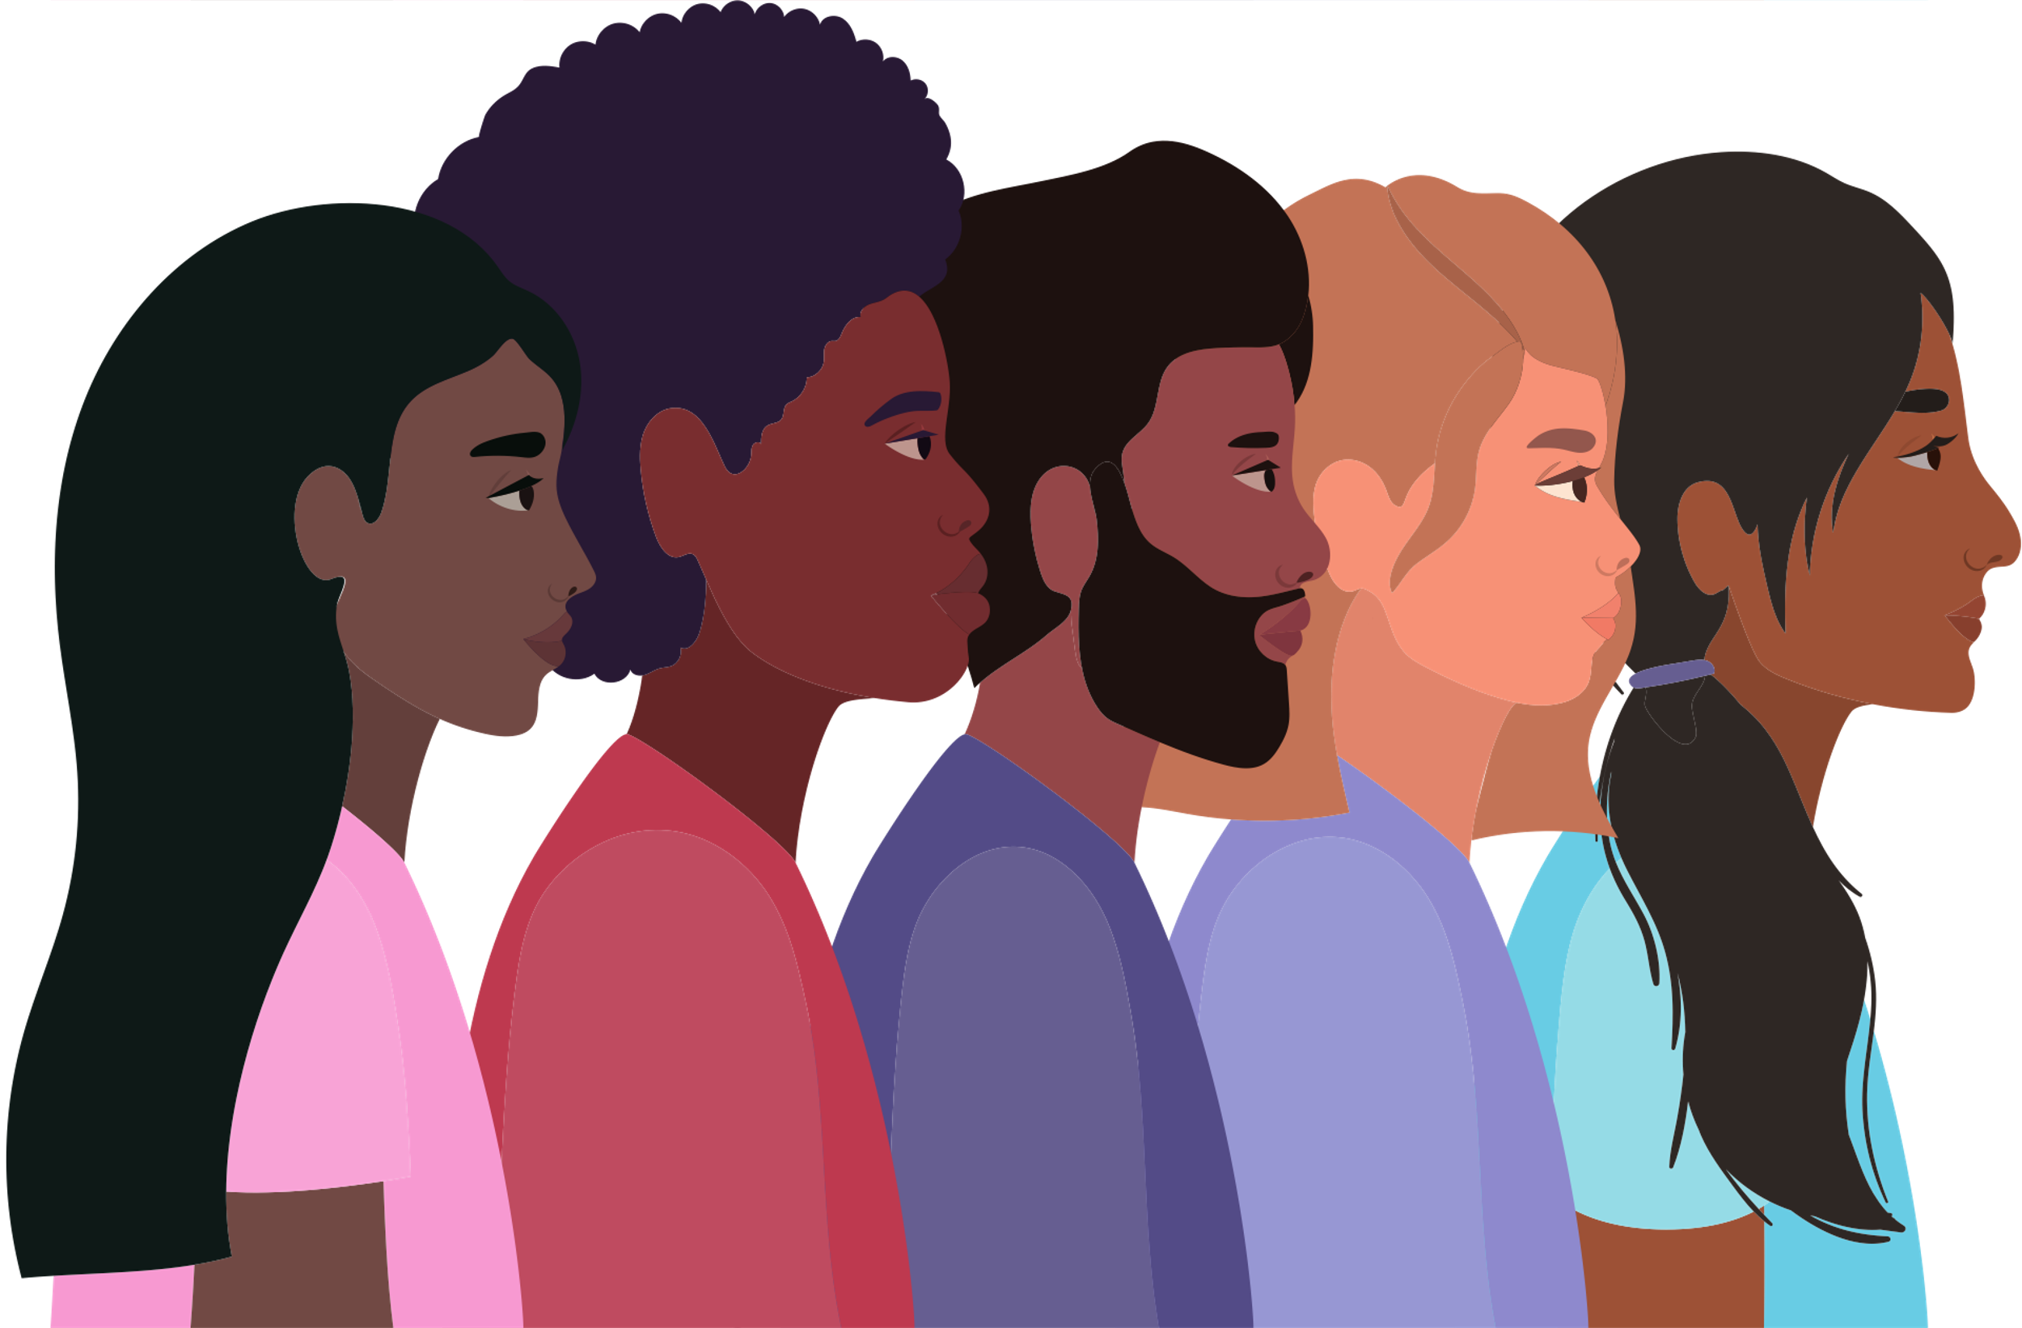
Racialized Stress
Well documented chronically high levels of stress faced by members of BIPOC community.
Caused by:
Poor social support
Low socioeconomic status
Interpersonal prejudice
Discrimination
Notes:
BIPOC: Black, Indigenous, People of Color
Numerous scientific studies have shown that when BIPOC individuals experience a high degree of prejudice, this can cause stress responses (e.g., high blood pressure, anxiety) that accrue over time, eventually leading to poor mental and physical health.

Slide 25
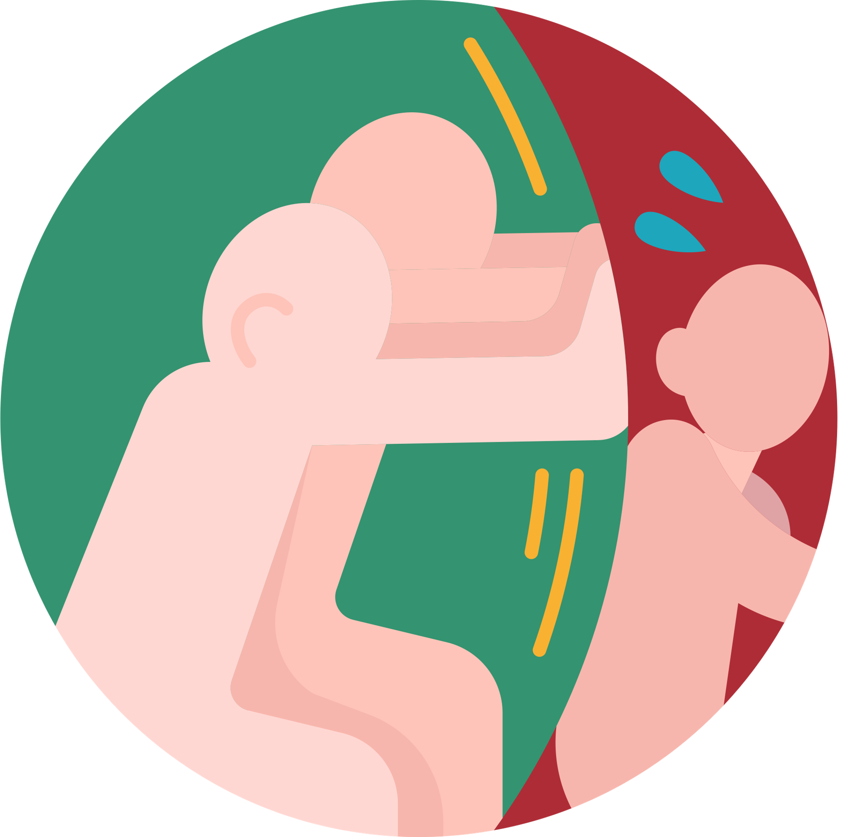
Racism
Racial prejudice rests on the belief that one’s own race is superior to another race
Health effects of experiencing racism are many:
High blood pressure
Cancer
Low birth weight in babies
Other chronic health conditions
Notes:
Being a person from a marginalized community comes with the recognition that they are potentially at risk for some sort of negative encounter and the level of threat perception in the environment is higher. That threat perception leads to hypervigilance, which leads to heightened allostatic load.
From Lecture 1- Allostatic load: It refers to damage wrought by persistent stress, which overtaxes the body’s delicate, regulatory mechanisms—including the immune, endocrine, and circulatory systems, and those regulating blood sugar and mood.
Daily experiences of discrimination are often less overt and more insidious, the offhand comments or small interactions sometimes known as microaggressions.

Slide 26
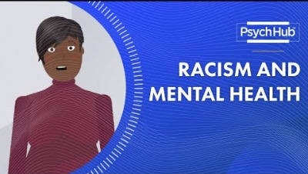
Notes:
https://www.youtube.com/watch?v=aV4Hk4PQ4Tc&t=6s
For further watching, please check out How Racism Makes Us Sick: https://www.youtube.com/watch?v=VzyjDR_AWzE
(optional)

Slide 27

Coping with Race Related Stress
Build a support network
Develop a Positive Cultural Identity and Strong Sense of Self
Make a plan around how you want to respond to microaggressions and other acts of racism when they occur.
Become involved in Social Justice efforts
Practice Self-care and Self-Compassion
Notes:
Build a support network
Connecting with other people with similar experiences can help you to feel validated and supported and you can learn how others have coped and handled situations. Finding a community with shared values as yours can also help you feel more connected and less isolated.
Develop a Positive Cultural Identity and Strong Sense of Self
This is particularly helpful in contending with race-related stress. Considering joining campus groups, clubs or associations that welcome your cultural norms and ideals, or cultural groups/community centres and events in the GTA that can offer cultural validation and a sense of connection and community.
Find positive role models or a mentor
Having someone to look up to and learn from how they navigated dealing with racism can also be helpful. Role models don’t have to be people you actually have met and have a relationship with - they can be public figures or historical figures that you can turn to for guidance. Reading autobiographies on such figures can offer support and inspiration. Finding a mentor who looks like you and has achieved something you aspire to can help you to stay motivated and encouraged.
Make a plan around how you want to respond to microaggressions and other acts of racism when they occur.
Decide what incidents are important for you to challenge and what is not. Document any potential acts of racism, talk to someone you trust about it, and consider reporting it. It is important to be informed of the relevant anti-racism policies that are in place in any institution or workplace you are connected to as well as the laws within Ontario and Canada at large.
Become involved in Social Justice efforts
Be strategic in social action and only take on what you feel you can manage without putting pressure on yourself or setting high expectations. Try not to get discouraged when changes are slow to happen, but also do not underestimate the power you have to facilitate change.
Practice Self-care and Self-Compassion
Be kind to yourself and attend to your emotions by acknowledging and accepting that your emotional reactions to racism make sense and that racism is painful. Use compassionate coping thoughts such as “this is a tough moment so I will be kind to myself”.

Slide 28
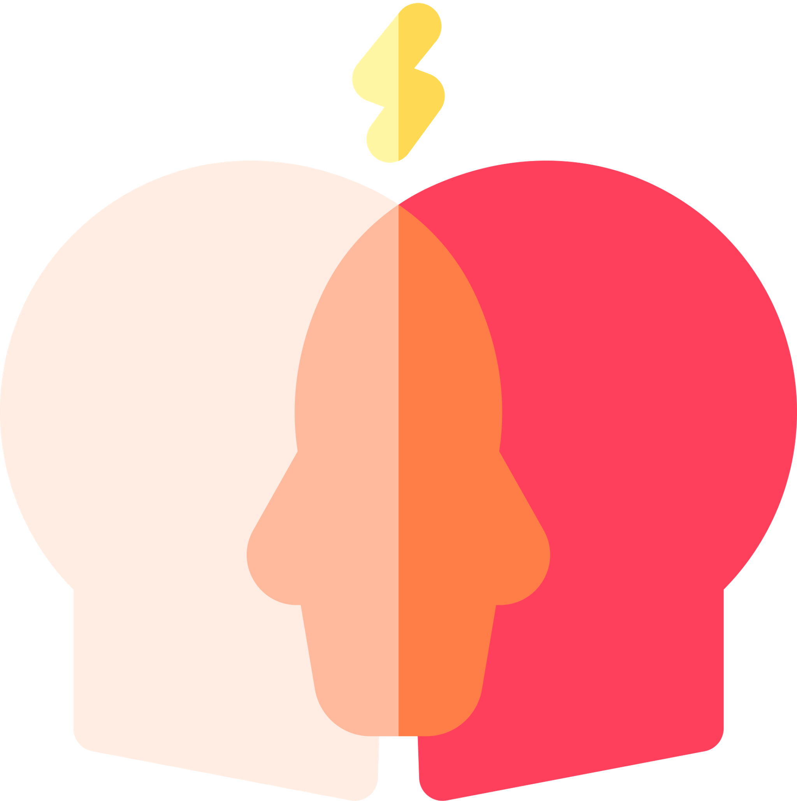
Other Sources of Stress
Cultural Clashes
When someone leaves one culture and enters another, there is a need to “fit in”
Some of the new culture’s standards may be at odds with the norms and values of the native culture
This culture clash can occur both intrapersonally and interpersonally
Notes:
What if your new culture is at odds with your native culture? Should you ignore the new culture’s standards and norms, and remain faithful to the familiar traditional standards and norms?
Further reading: https://newcanadianmedia.ca/immigrant-parents-struggle-with-cultural-clashes/

Slide 29
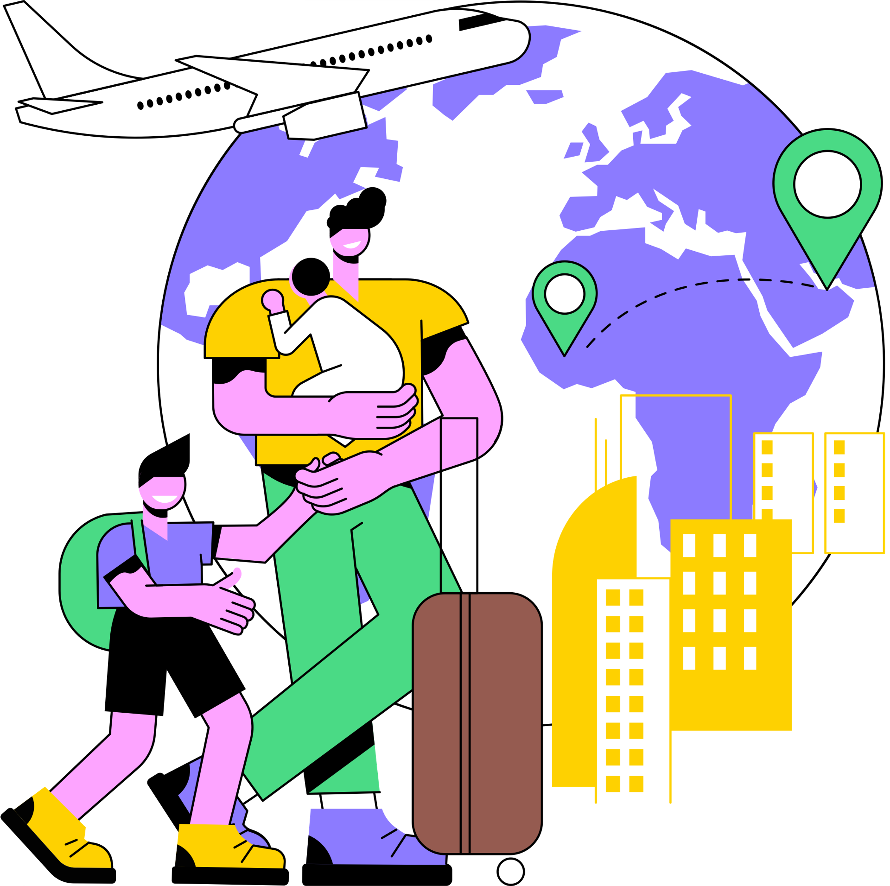
Other Sources of Stress
Acculturation Stressors
Entering a new culture requires adaptation
Language barriers
Employment difficulties
Children acculturate faster than parents
Racial profiling
Hate crimes
Notes:
As has been shown, entering a new culture often requires a great deal of adaptation, which often results in stress and ill health. The balancing of two cultures may explain the higher blood pressure, mental illness, and higher rates of attempted suicide among immigrants when compared with the population in their country of origin.

Slide 30
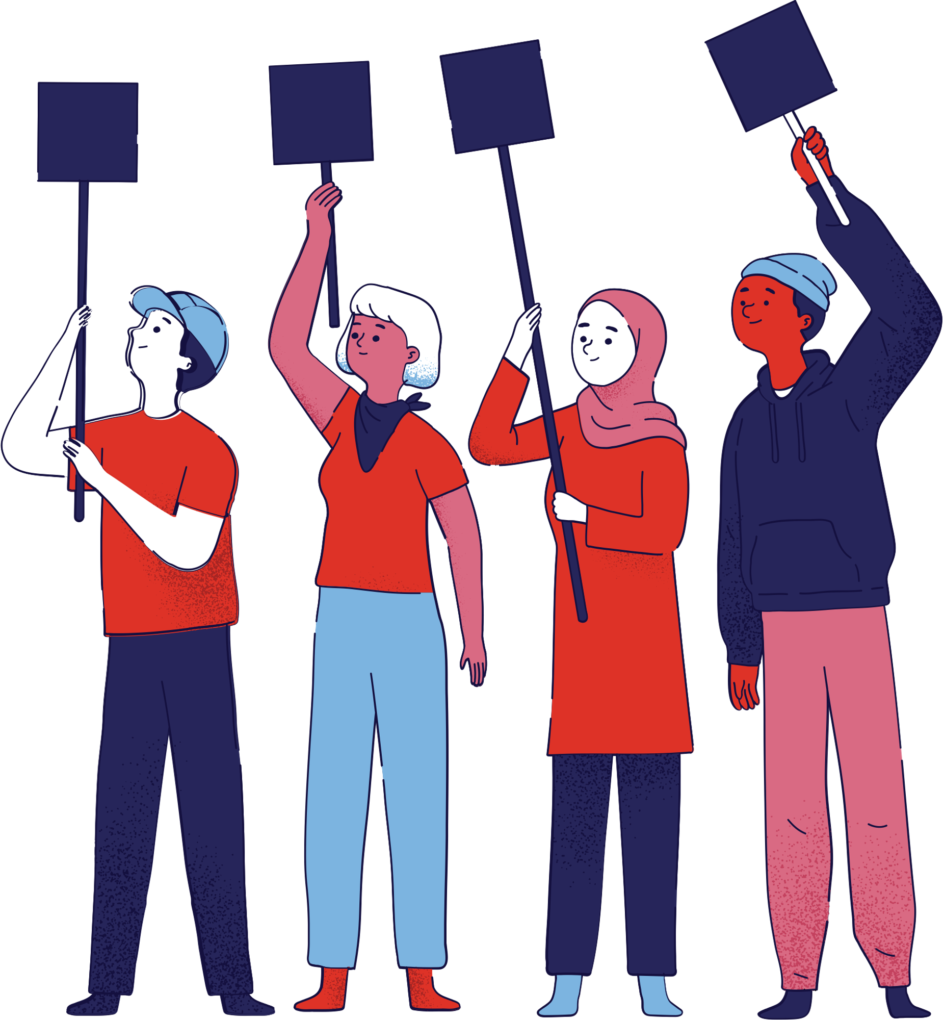
Health Status Differences
Health care disparities: A particular type of health difference that is closely linked with social, economic, and/or environmental disadvantage
Adversely affect groups of people who have systematically experienced greater obstacles to health
Notes:
The impact of discrimination throughout a lifetime can lead to chronic stress and trauma.
There is growing evidence of the negative effects of chronic stress and experiences of trauma on mental and physical health. Importantly, these effects can be felt by individuals, families, and communities across generations.
Processes of interpersonal and institutional discrimination also reduce access to the material and social resources needed to achieve and maintain good health over a lifetime.
Inequities in access to education, income, employment, housing, and food security can drive inequities in health and wellbeing
Intergenerational effects, like the inability to transmit wealth, which can shape the life chances of each new generation.

Slide 31
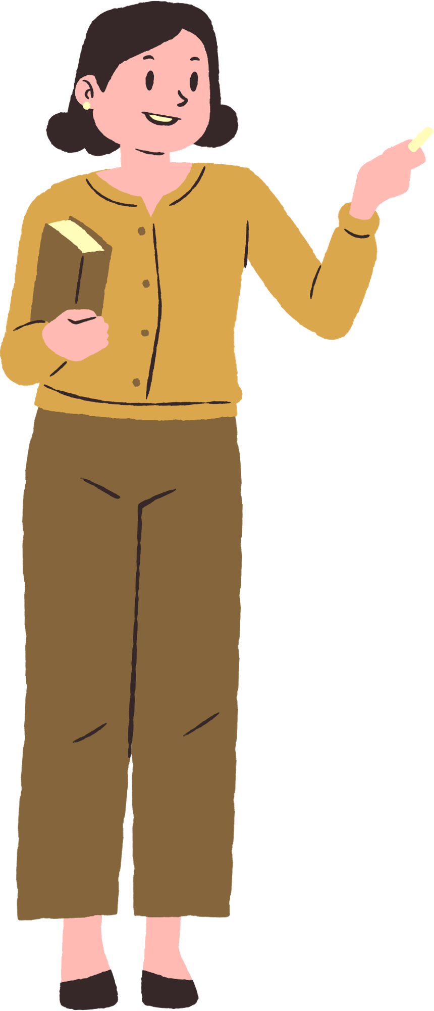
Health Status Differences in Minorities
Covid-19
Communities with more visible minorities and recent immigrants 3x more likely to test positive for covid than less diverse neighbourhoods
Heart Disease
Much more common in Black Canadians – higher levels of stroke, perinatal disease and diabetes
Substance misuse
LGBTQ individuals are 2.5x more likely to have substance misuse vs. heterosexual individuals
Mental health
Poorer mental health and poorer use services in visible minorities
Higher rates of mental illness in the LGBTQ+ community
2.5x more likely to have a mental disorder in their lifetime
Higher rates of depression and generalized anxiety self-reported by females vs males
Suicide
Females have more thoughts of suicide vs males in their lifetime
Notes:
Covid-19: Racialized individuals are more likely to work in low paying jobs with limited access to paid sick leave, and live in poorly maintained, unstable or crowded housing, all of which have been associated with poorer COVID-19 outcomes. These issues are rooted in systemic racism, the system by which existing policies and structures reinforce and perpetuate racial inequities, and has been consistently linked with poorer general and physical health outcomes. Many of the proposed COVID-19 interventions, such as physical distancing and working from home, are issues of privilege, and may not be accessible to those in the most marginalized communities.
Persistent exposure to chronic stressors, such as poor living and working conditions, has been observed to increase stress hormones, which has been hypothesized as a contributing factor to chronic diseases.
Ethnic differences in high blood pressure: some experts think that social and economic factors -- including discrimination and economic inequality -- are responsible for this difference.
Health disparities among LGBTQ people are linked to stigma and discrimination- for example: many LGBTQ+ people have reported experiencing stigma and discrimination, when accessing health services, leading some individuals to delay necessary health care or forego it altogether. These individuals may have less social support than heterosexual individuals, particularly if they live in a region without a large LGBTQ population or if they have experienced rejection by their family of origin. Transgender individuals have higher rates of poverty and unemployment than non-transgender individuals.

Slide 32
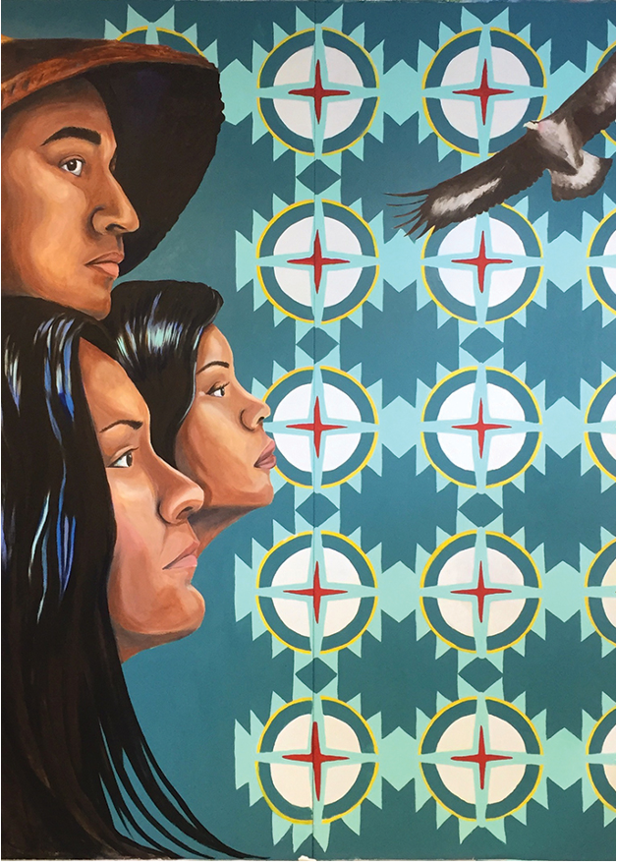
Indigenous Peoples’ Health
Infant mortality twice as high as compared to NICs
Higher prevalence of arthritis, asthma, diabetes, and obesity
Suicide mortality was also relatively high in areas with a high concentration of Indigenous peoples
2-3x higher levels of mental health hospitalizations in Indigenous populations
Less likely to report very good or excellent mental health vs NICs
Twice as likely to report having had suicidal thoughts, both in their lifetime
Notes:
NICs: non-Indigenous Canadians Why?​
Unequal access: to high quality health care
​Underinvestment in family support and health care programs
​Underrepresentation in scientific and professional jobs in health care
Lack of education for health care professionals regarding issues of race, power and privilege​
Transgenerational trauma: Indigenous people have experienced significant trauma due to the destruction of their lands and culture as a result of European colonization. High quality health care is inaccessible in many Indigenous communities in Canada. Less likely to seek medical care.

Slide 33
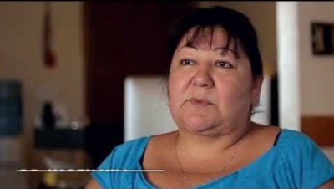
Notes:
https://youtu.be/nVQU1EmoWoU
Bridging the gap between traditional and western medicine
Further watching: Indigenous Knowledge to Close Gaps in Indigenous Health- https://www.youtube.com/watch?v=IpKjtujtEYI

Slide 34
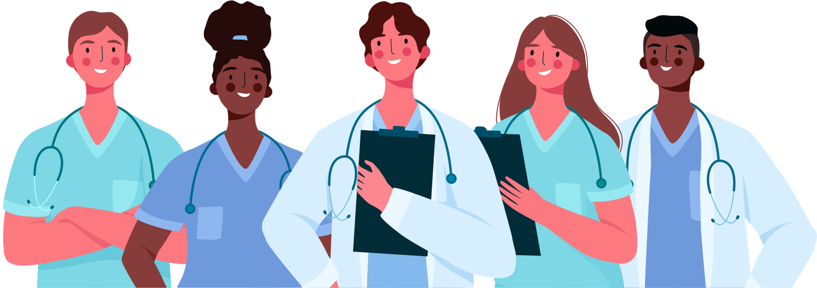
Reducing Health Disparities
Acknowledgment of implicit biases among healthcare professionals that are deeply rooted in our society
Increase the diversity of the medical profession
Commitment to addressing social determinants of health
Improving quality of healthcare for marginalized communities
Improving access to patient-centered care that is responsive to their unique needs
Notes:
Other strategies:
Training healthcare workers cultural competence and literacy to achieve health equity by mitigating disparity factors in the patient population.
Working with community partners to create more access to areas for physical activity, such as recreation centres, gyms and parks.
Creating outreach programs to helps people learn skills to manage their health by teaching goal-setting and problem solving skills that help remove barriers to maintaining a healthy lifestyle.
Further reading: https://www.utoronto.ca/news/we-need-ensure-cultural-shift-u-t-s-onye-nnorom-why-canada-needs-more-black-physicians

Slide 35

Mindful Moment
Notes:
https://www.youtube.com/watch?v=UEX2mtq1r9Y

